Slide 1
Mangroves:
Protectors of the Coast

Slide 2
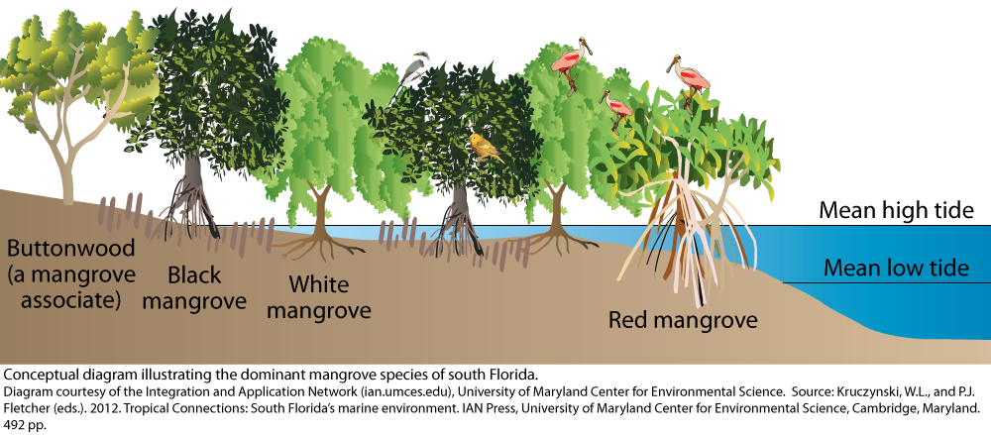
4 species of mangroves are found in Florida:
The red mangrove, white mangrove, black mangrove and buttonwood.

Slide 3
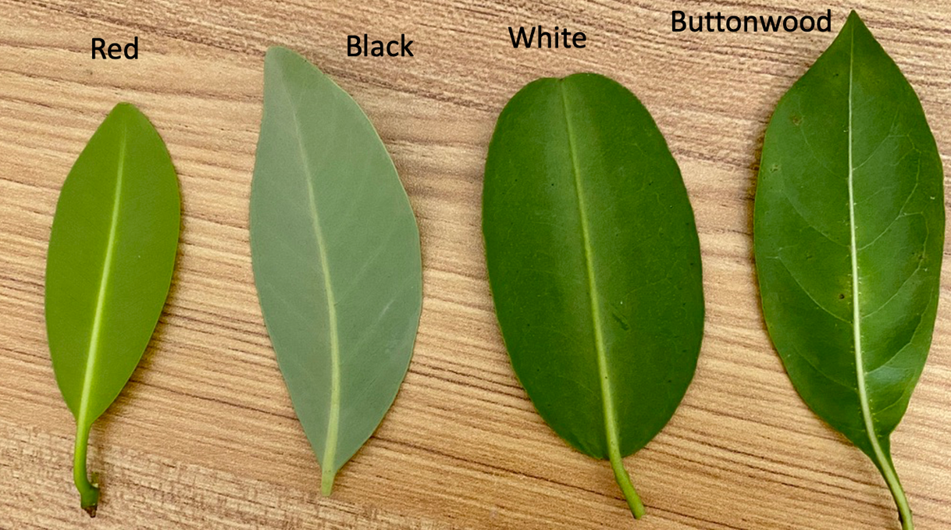

Slide 4
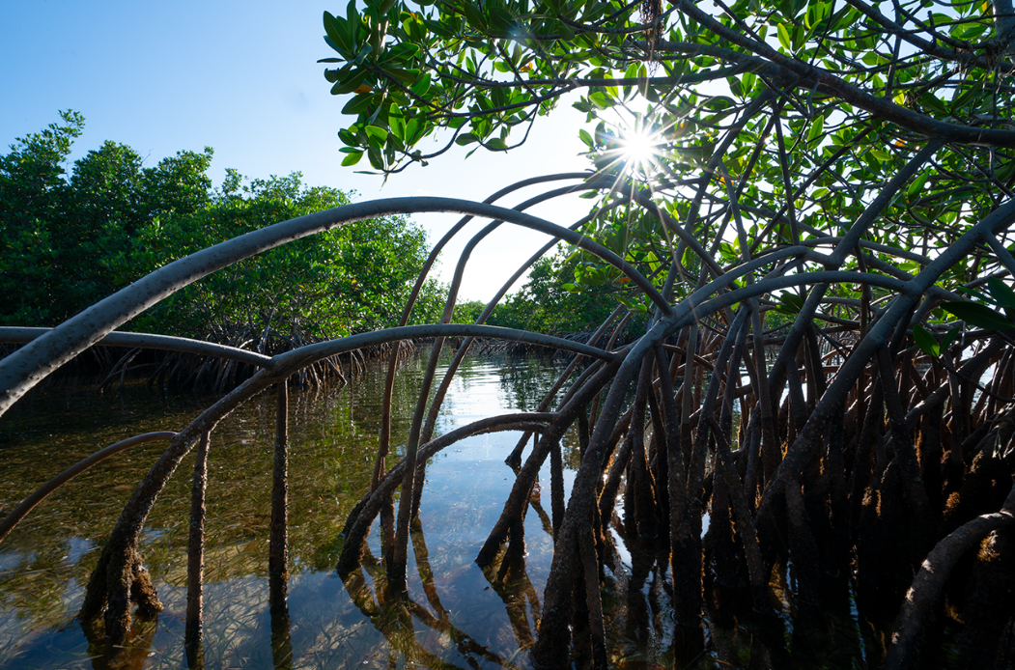
A group or forest of mangrove trees is called a Mangal

Slide 5
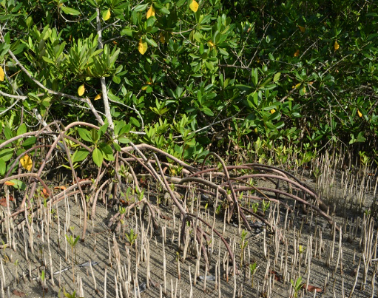
Black mangroves have roots structures that stick out of the ground like straws called pneumatophores.

Slide 6
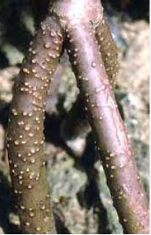
Red mangroves are covered with lenticels. Lenticels are pore-like structures along their roots that allow for gas exchange, so the trees can survive in oxygen-poor environments.

Slide 7
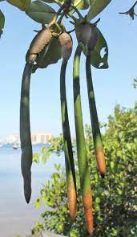
Red Mangroves are Viviparous. This means the plant reproduces while still attached the the parent plant.
Viviparous means “bearing live-young.”

Slide 8
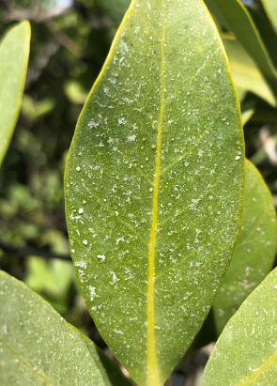
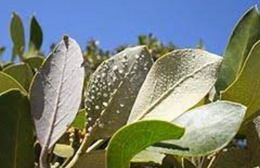
White and black mangroves adapt to survive in sea water through salt excretion.
When the tree roots take in water to grow, the salt is excreted on to the leaves. Leaving behind small salt crystals on the leaves. This is specifically visible on black mangroves.

Slide 9
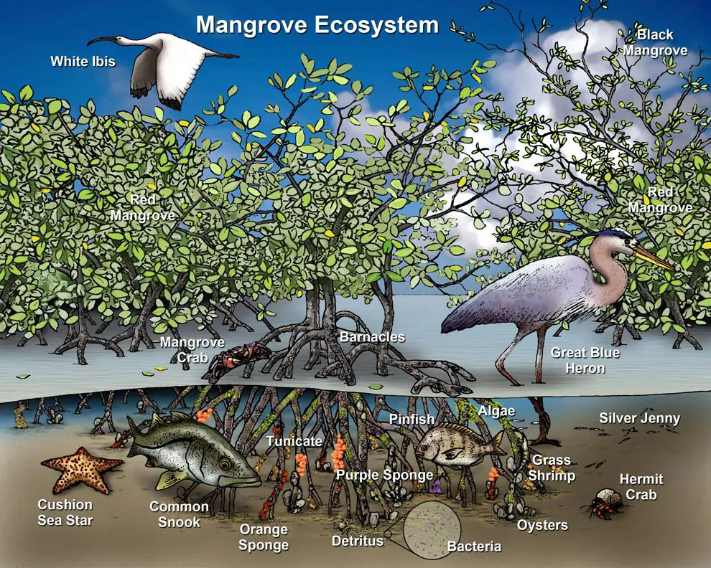
Wildlife in the Mangroves
Migratory and resident birds
Fish Nurseries
Rainbow parrotfish and goliath grouper
crabs and mollusks

Slide 10
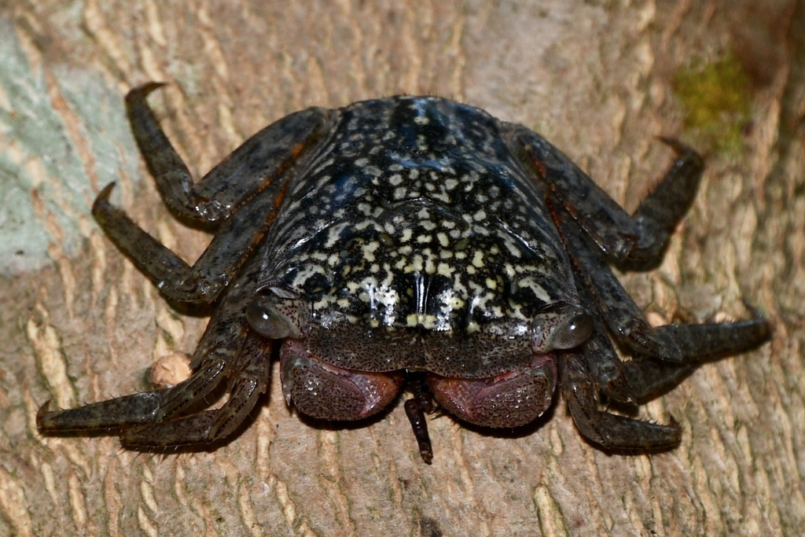
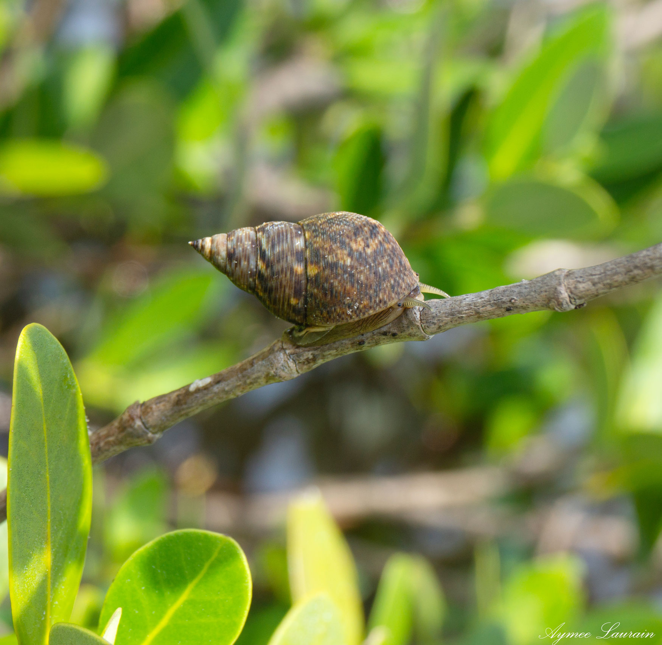
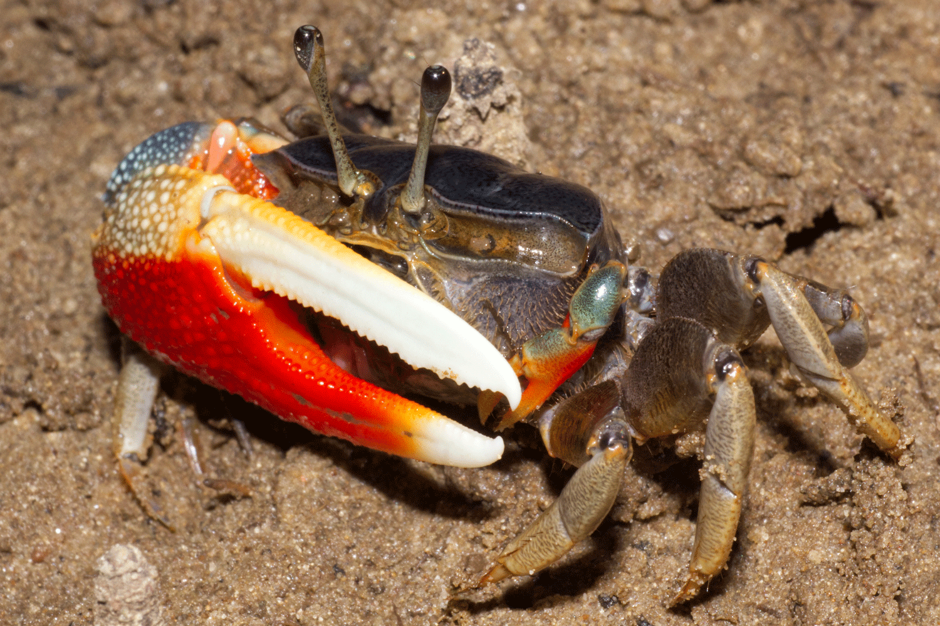
Mollusks and Decapods Found in Mangrove Forests
Mangrove Tree Crab
Mangrove Periwinkle
Fiddler Crab

Slide 11
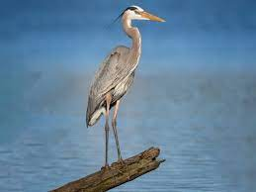
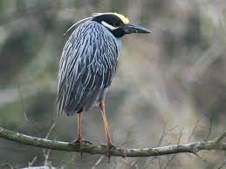
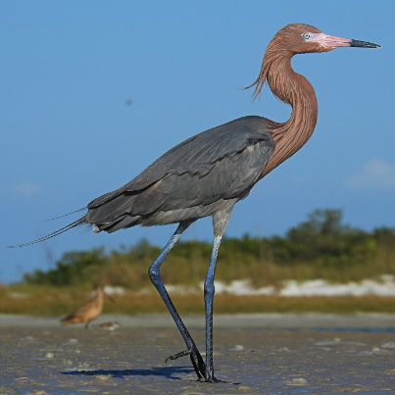
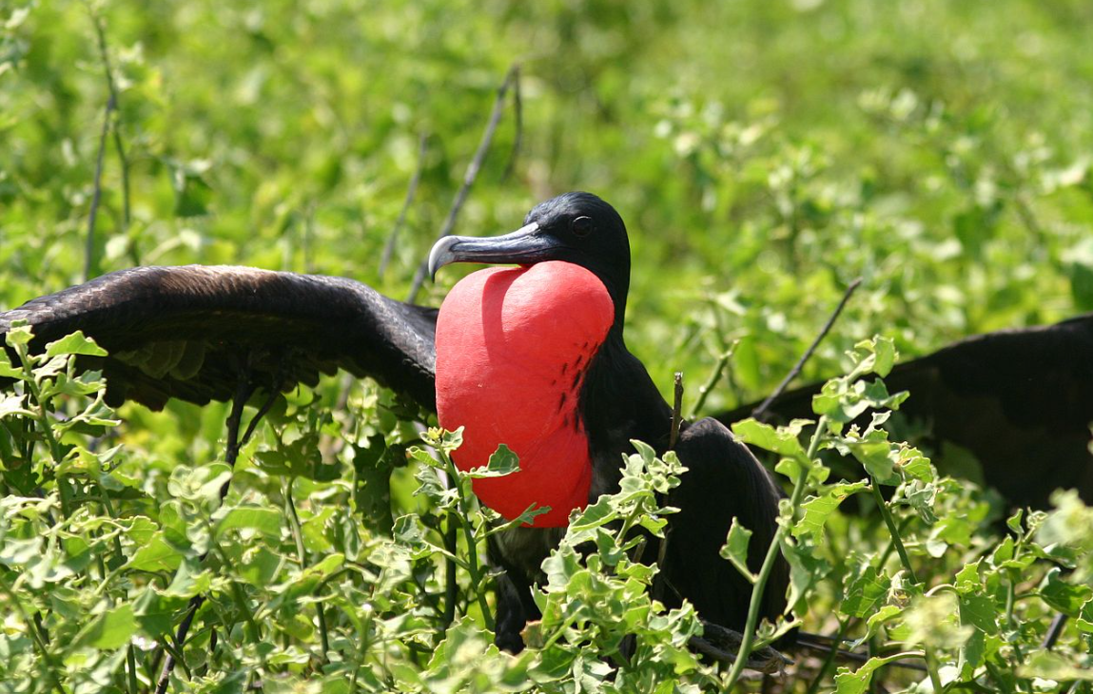
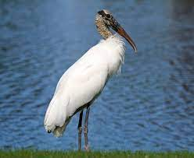
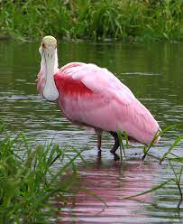
Birds Found in Mangrove Forests
Blue Heron
Yellow-crowned Night Heron
Reddish Egret
Great Frigate Bird
Wood Stork
Roseate spoonbill

Slide 12
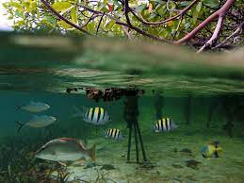
Fish Nurseries
Tangled root systems provide shelter for juvenile wildlife species such as
Goliath grouper
Rainbow parrotfish
The roots also provide safety from large predators, allowing them to eat and grow

Slide 13
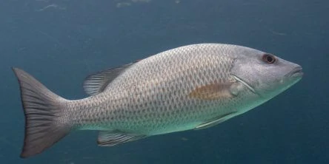
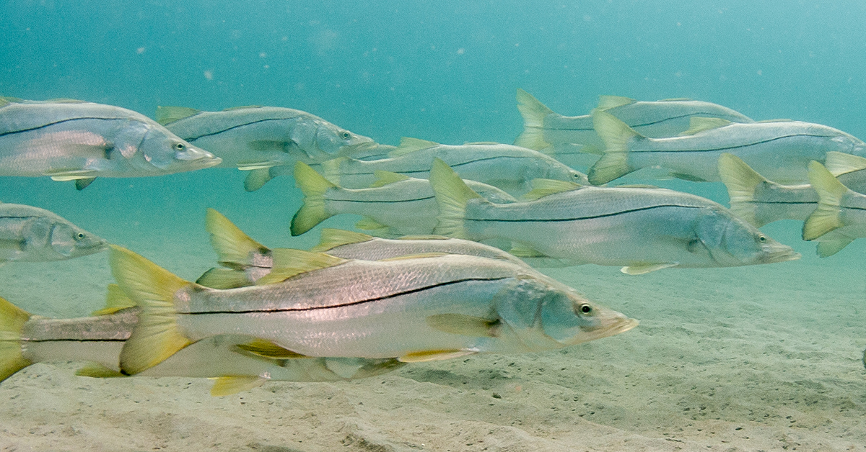
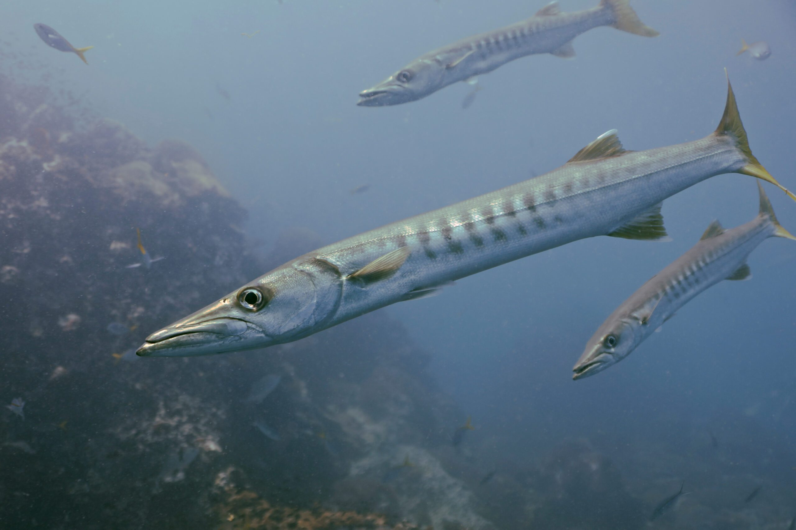
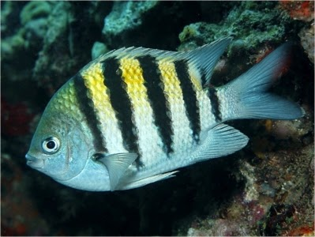
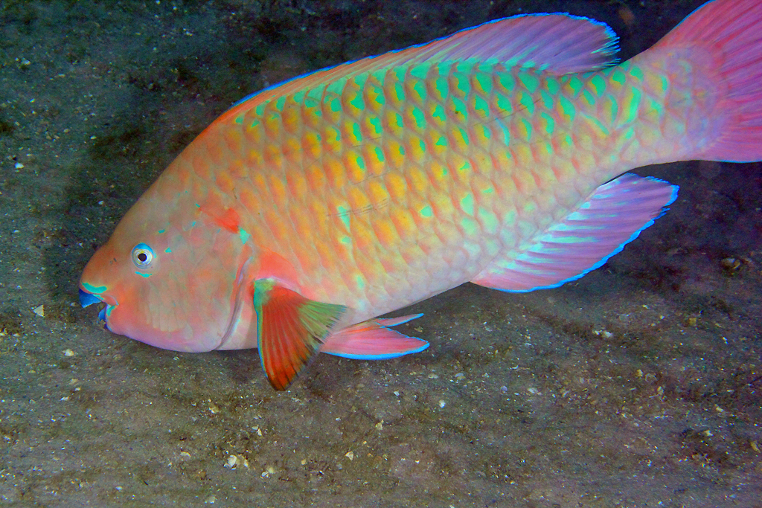
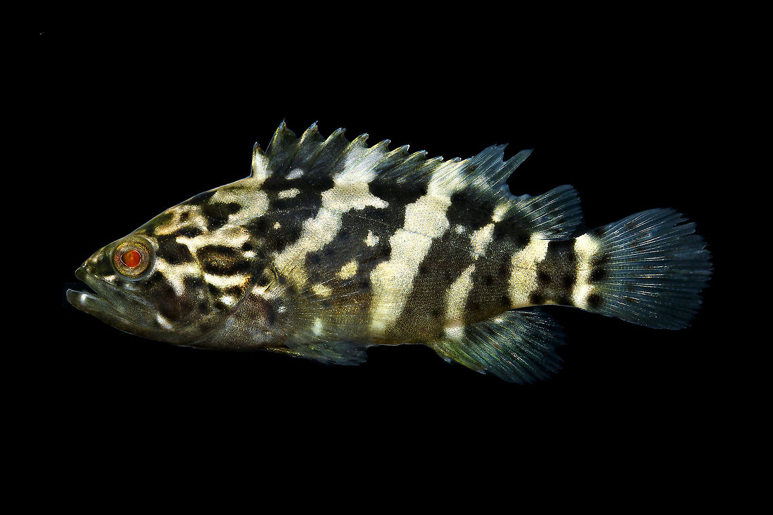
Fish Found in Mangrove Forests
Mangrove Snapper
Snook
Barracuda (Juveniles)
Sergeant Major
Rainbow Parrotfish
Goliath Grouper (Juveniles)

Slide 14
Mangroves Prevent Erosion
Mangroves’ root systems create a buffer zone from storms, hurricanes, and flooding. The roots stabilize the sediment from moving and eroding away from wave forces.

Slide 15
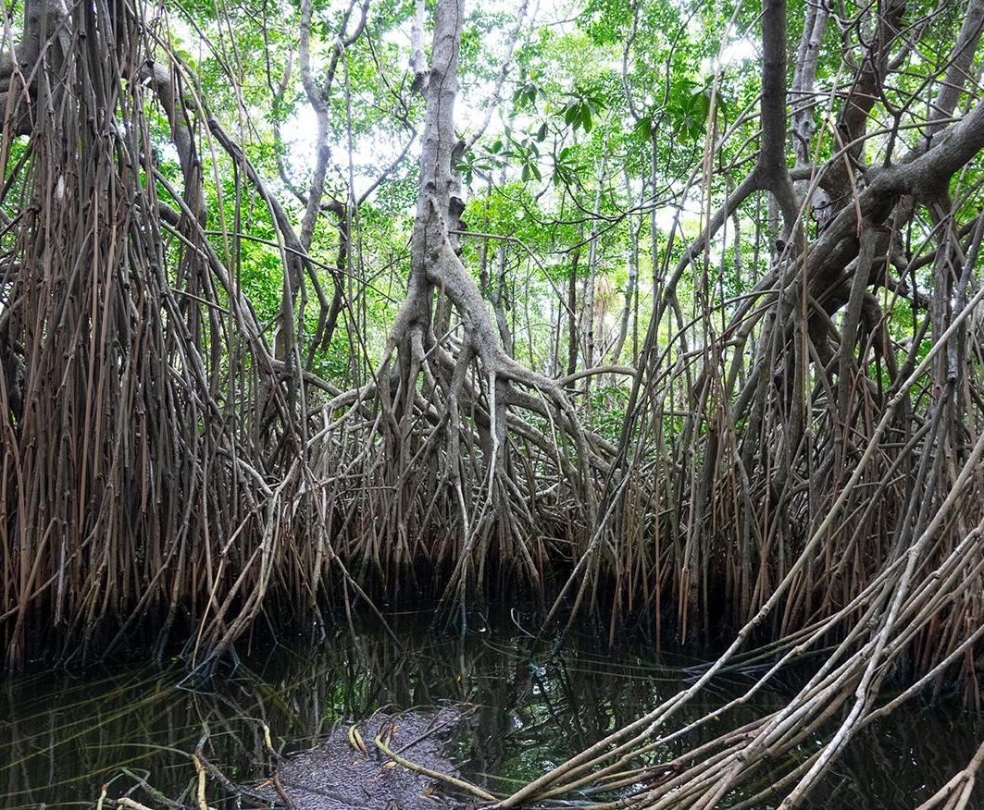
Mangroves and Climate Change
Scientists have found that mangrove trees in aquatic habitats sequester, or store 10x more carbon than trees living on land.
If mangrove forests are destroyed, the stored carbon will be released into the atmosphere as carbon dioxide. This can directly affect greenhouse gas levels in the atmosphere and contribute to climate change.

Slide 16
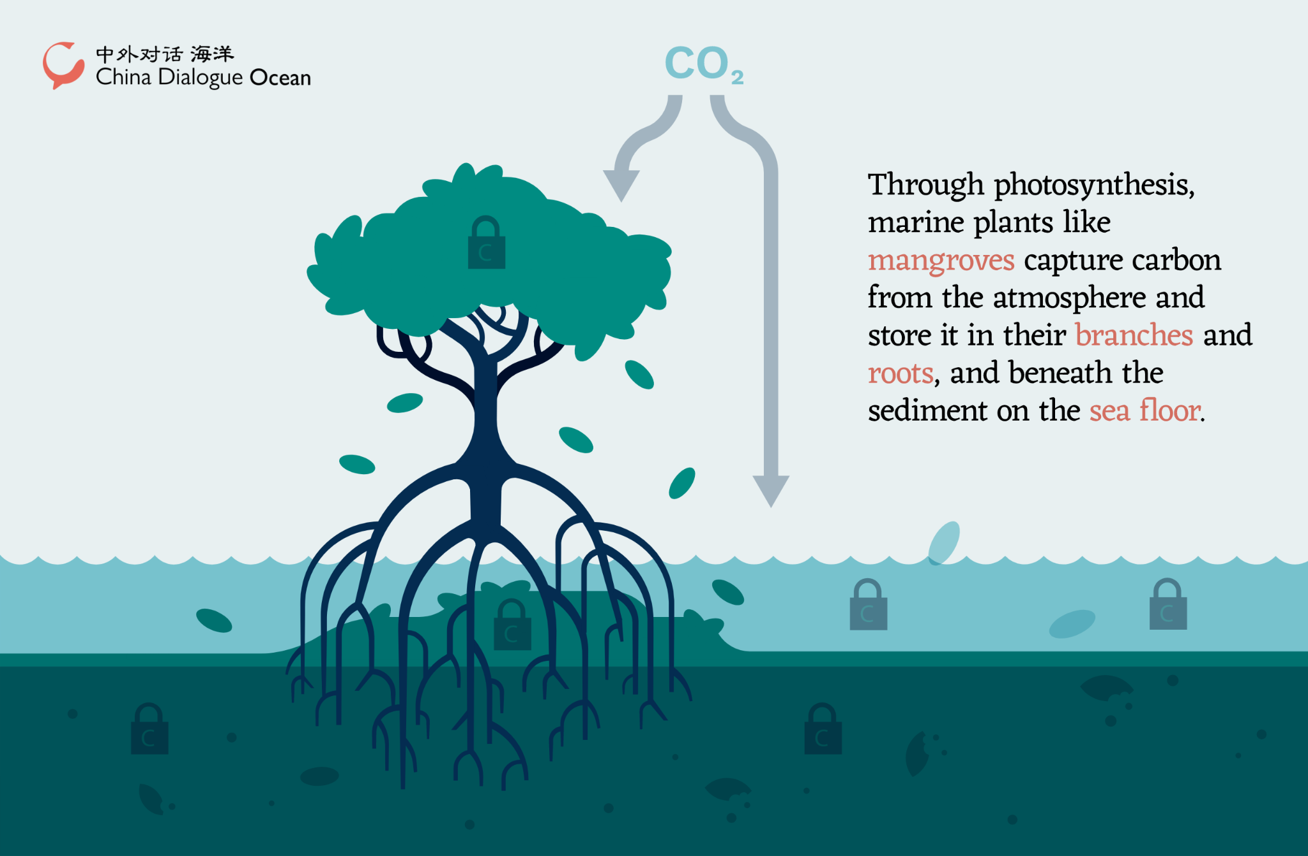
Carbon sequestration refers to the process of storing carbon in trees

Slide 17
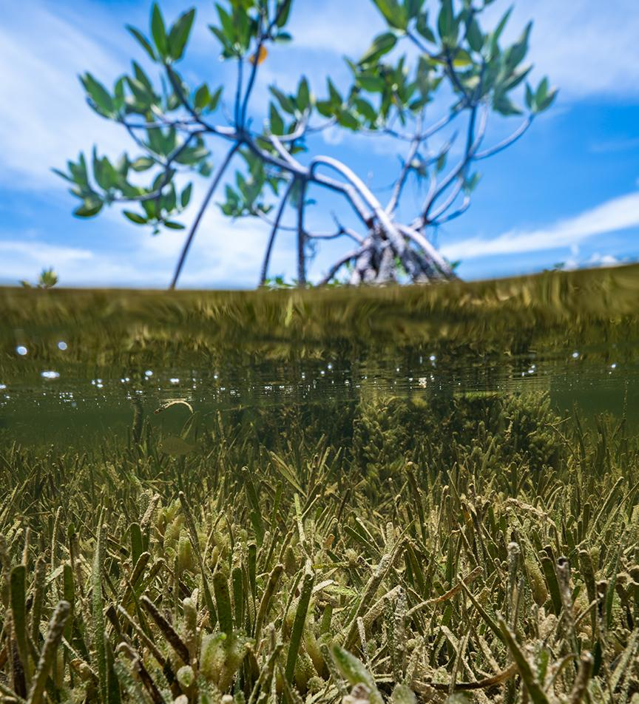
Accumulation of Organic Matter
Mangroves grow in aquatic habitats with constant flooding.
When leaves fall off the trees they sink to the bottom of the water. This leads to a thick layer of organic matter on the seafloor, increasing the amount of carbon present.

Slide 18
Why are Mangrove Forests Important to us?
Mangroves are important to humans too due to the multitude of ecosystem services they provide.
Ecosystem Services: The benefits that natural ecosystems provide for human well-being
Mangroves provide humans with food in the form of fish and crustaceans, they protect our coasts from erosion and storm surge, and they help mitigate against climate change!

