Slide 1
The
Life Cycle
of the
Red Mangrove

Slide 2
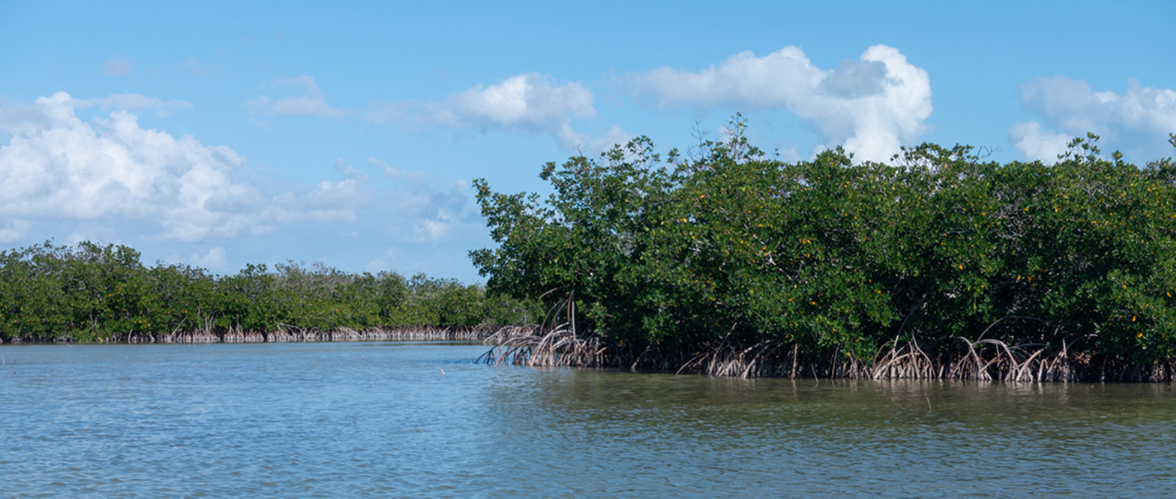
Why are red mangroves important?
Their tangled root systems allow these trees to stabilize the sediment from erosion and keep the trees sturdy during tidal changes.

Slide 3
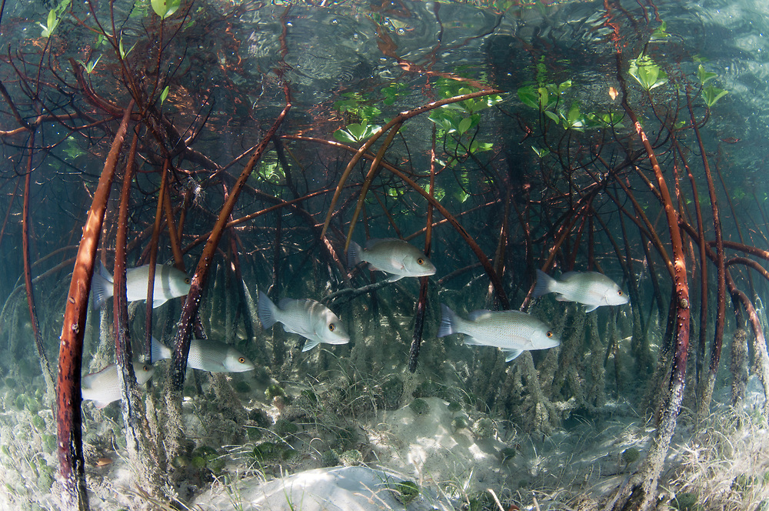
Why are red mangroves important?
They provide safety for juvenile fish from predators

Slide 4
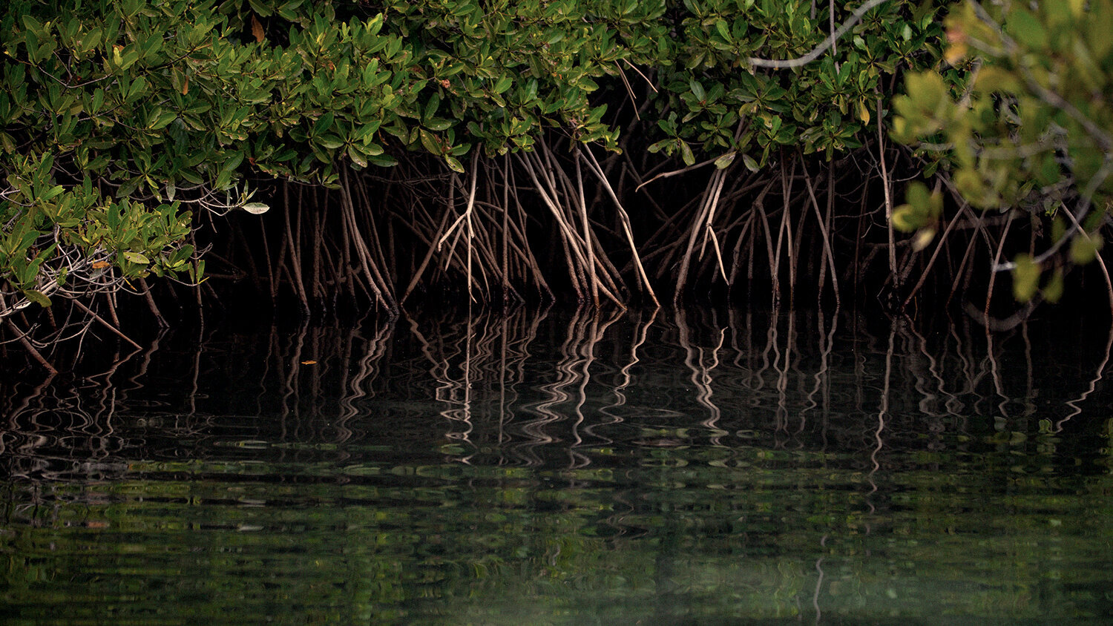
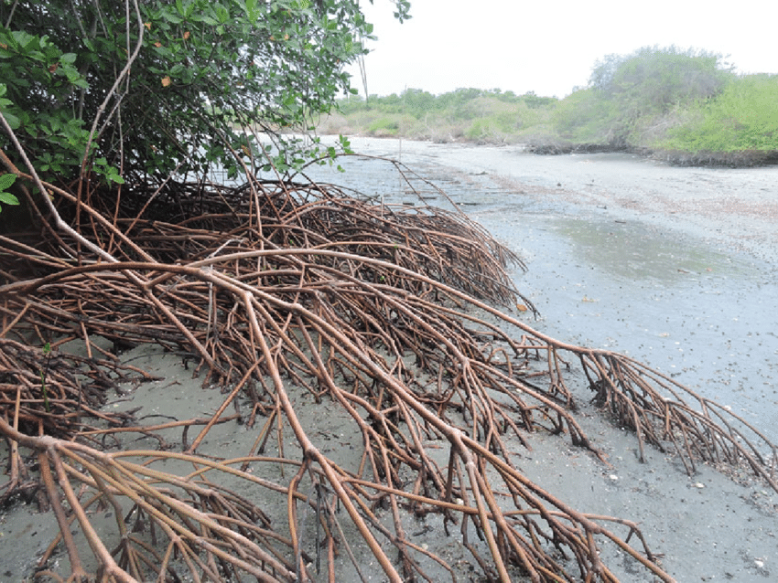
Where do they grow?
Red mangroves grow along the shoreline because they prefer areas that experience constant flooding and tidal changes.
High tide- tree roots are submerged.
Low tide- roots are exposed to the air with damp soil below.

Slide 5
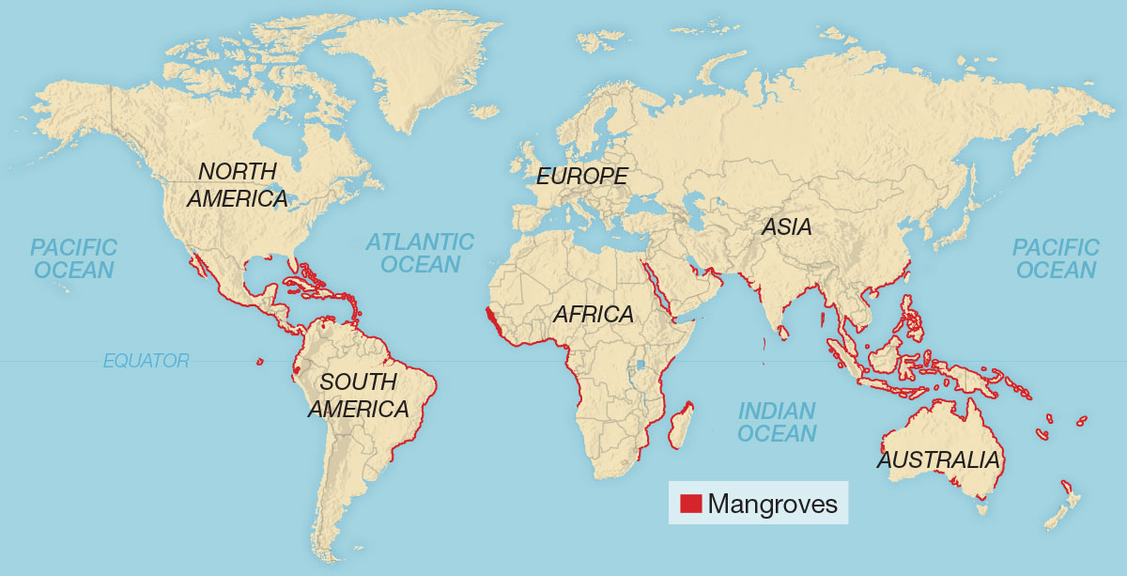
Global Mangrove Distribution Map

Slide 6
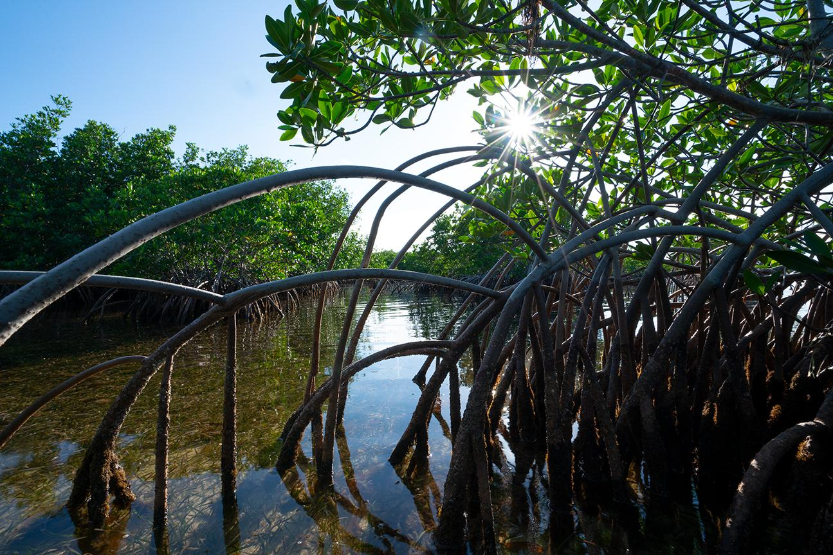
How have they adapted?
Their distinctive arching roots allow the trees to grow in water that can be several feet deep.
Red mangrove roots are called prop roots.

Slide 7
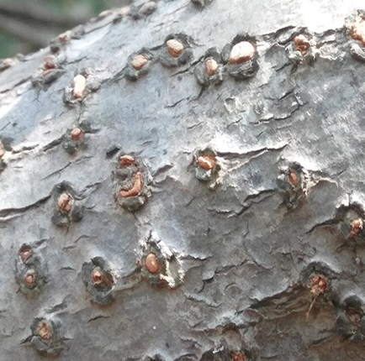
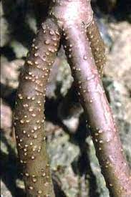
How have they adapted?
Red mangrove roots are covered in lenticels.
Lenticels are pore-like structures along their roots that allow for gas exchange, so the trees can survive in oxygen-poor environments.

Slide 8
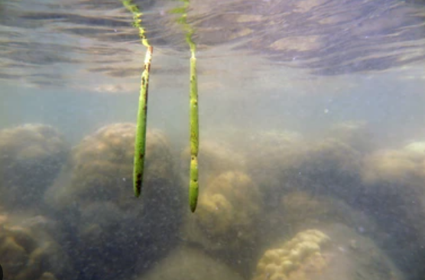
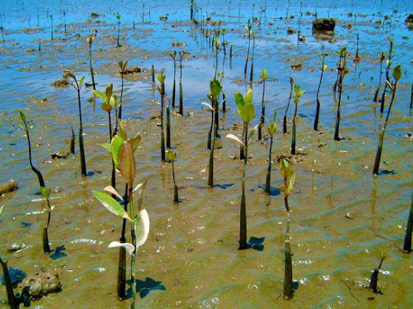
The Power of Propagules
Red mangroves are viviparous.
Viviparous essentially means “bearing live young.”

Slide 9
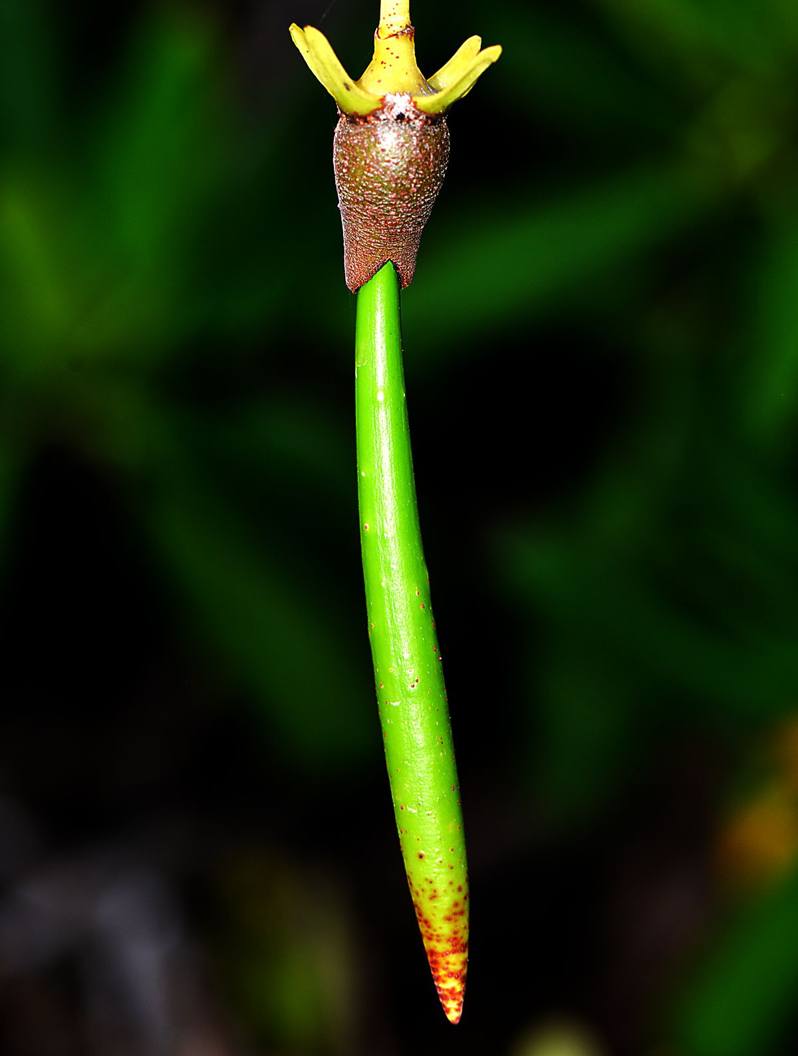
The Power of Propagules
Instead of dispersing its seeds, red mangrove seeds germinate while still attached to the tree. The germinated seed grows into what is called a propagule.
A propagule is essentially a pre-packaged, baby mangrove tree.

Slide 10
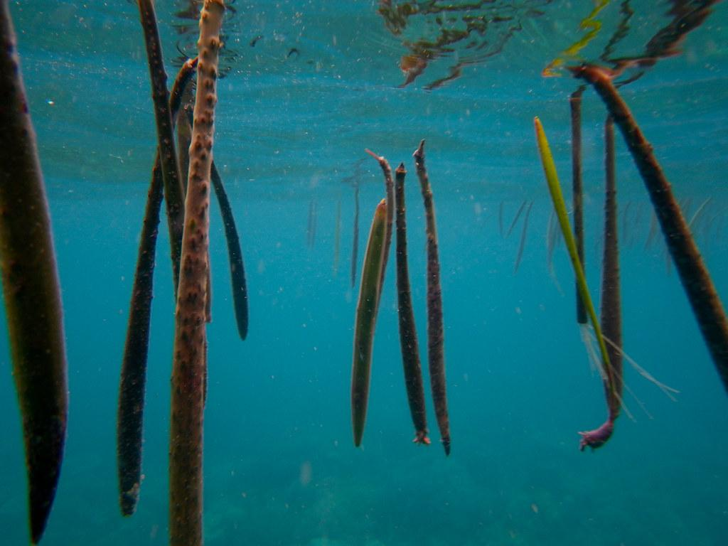
How is the propagule beneficial for the distribution of the red mangrove?
Propagules can float for many days after falling from their parent tree.
Since red mangroves live so close to the coast, this allows the fallen propagules to use the ocean currents to distribute the species far and wide.

Slide 11
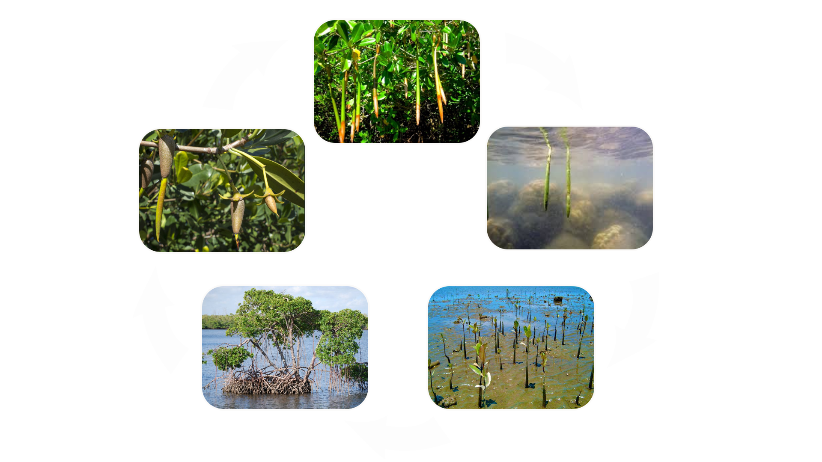
Red Mangrove Life Cycle

Slide 12
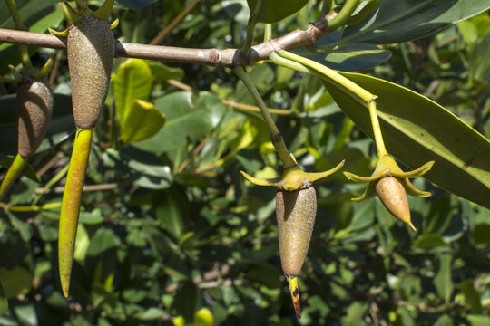
Step 1: Germination
The germinated seed develops into a propagule while still attached to the parent tree

Slide 13
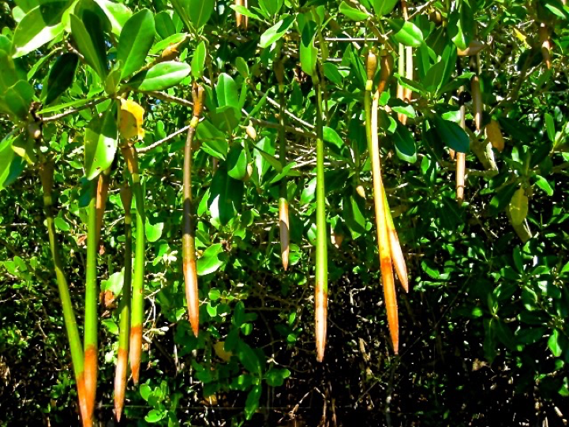
Step 2: Propagule Growth
The propagule grows to about 6 inches before detaching from the tree and falling into the water.

Slide 14
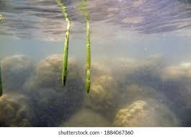
Step 3: Water Travel
The propagule floats horizontally in the water until it becomes waterlogged and vertically plants into the ground.

Slide 15
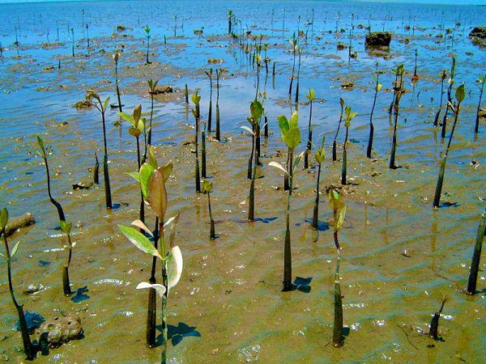
Step 4: Propagation
Eventually, the propagule plants vertically into the soil and starts to grow into a juvenile mangrove tree.

Slide 16
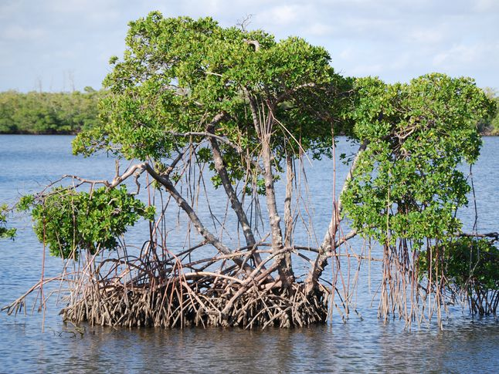
Step 5: Adult Tree
Grows into an adult mangrove tree that eventually produces its own propagules that starts the cycle over again

