Slide 1
The Florida Manatee

Slide 2
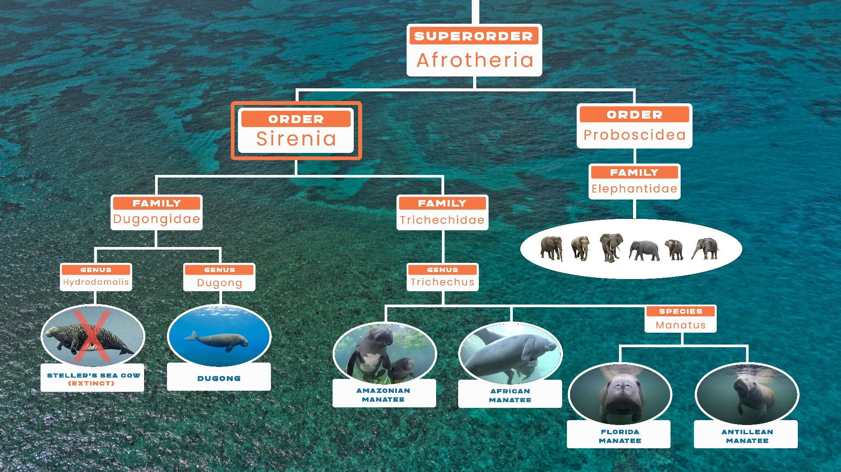
Taxonomy What, exactly, is a manatee?

Slide 3
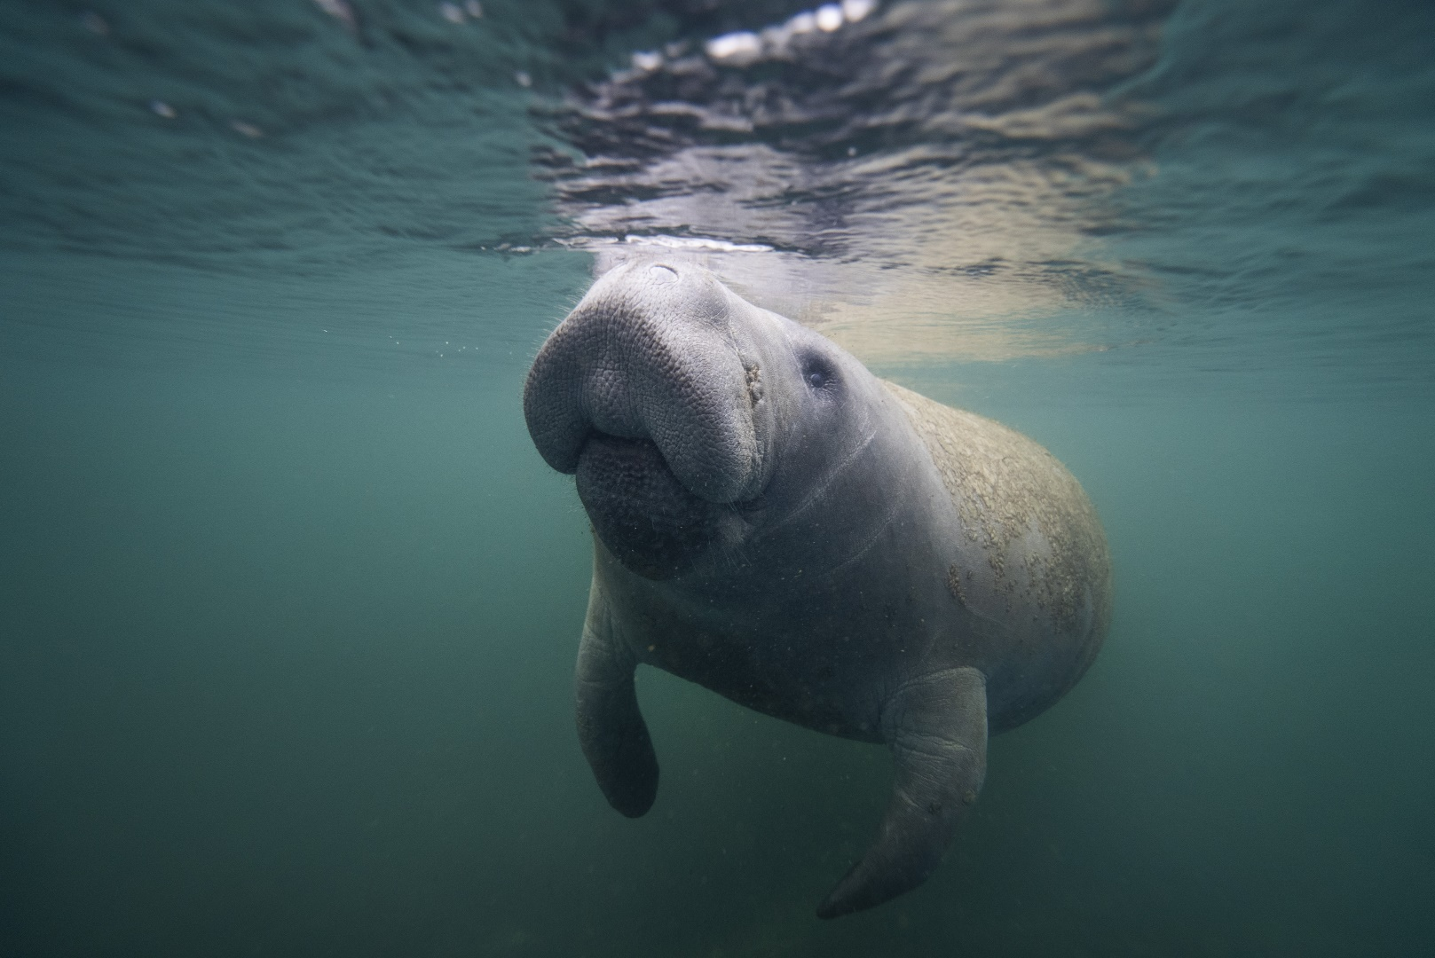
Sirenians are herbivorous, aquatic mammals, distantly related to elephants. They’re often called “Sea Cows,” for obvious reasons.

Slide 4
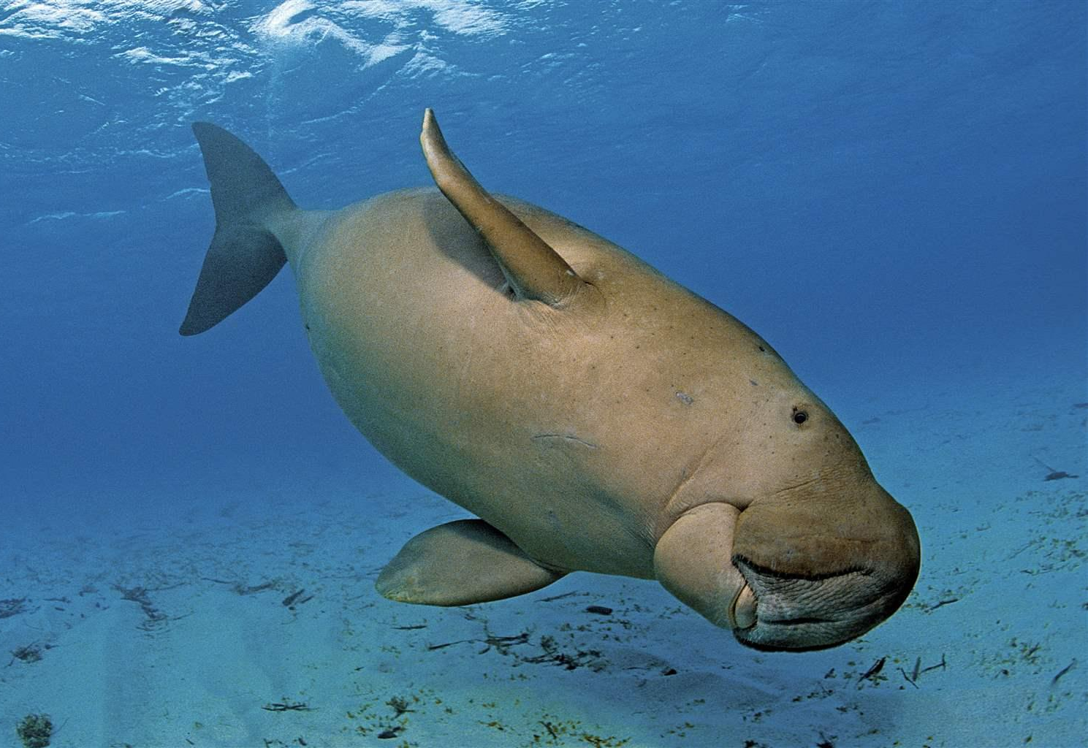
Manatees belong to the order Sirenia
This order includes two families: Dugongidae, and Trichechidae.
The family Dugongidae is comprised of two species. The dugong is the only living species in this family. This vulnerable species can be found in the Indo-West Pacific area.

Slide 5
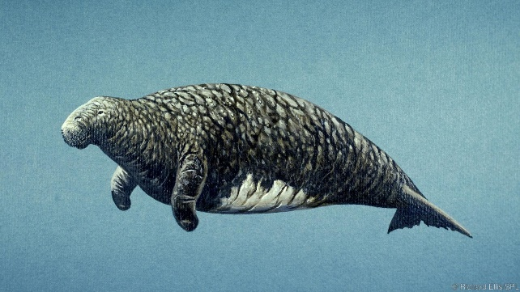
The Steller’s Sea Cow
This gentle giant, growing to 30 feet in length, was hunted to extinction 27 years after its “discovery” by European explorers.

Slide 6
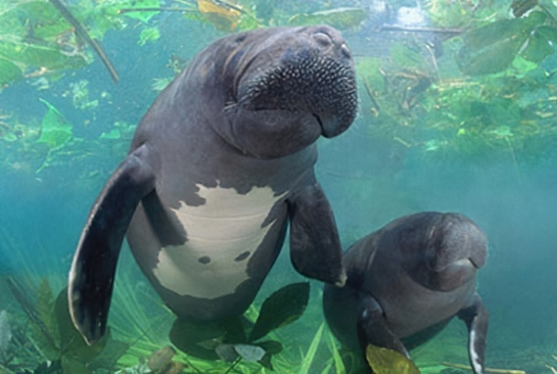
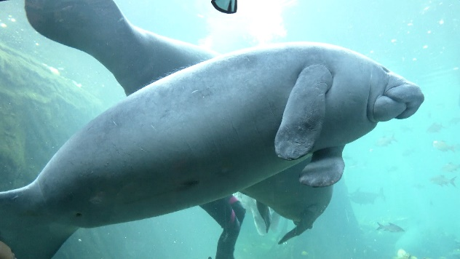
The family Trichechidae includes 3 species:
African manatee
Amazonian manatee
West Indian manatee

Slide 7
The West Indian Manatee is comprised of two sub-species:

Slide 8
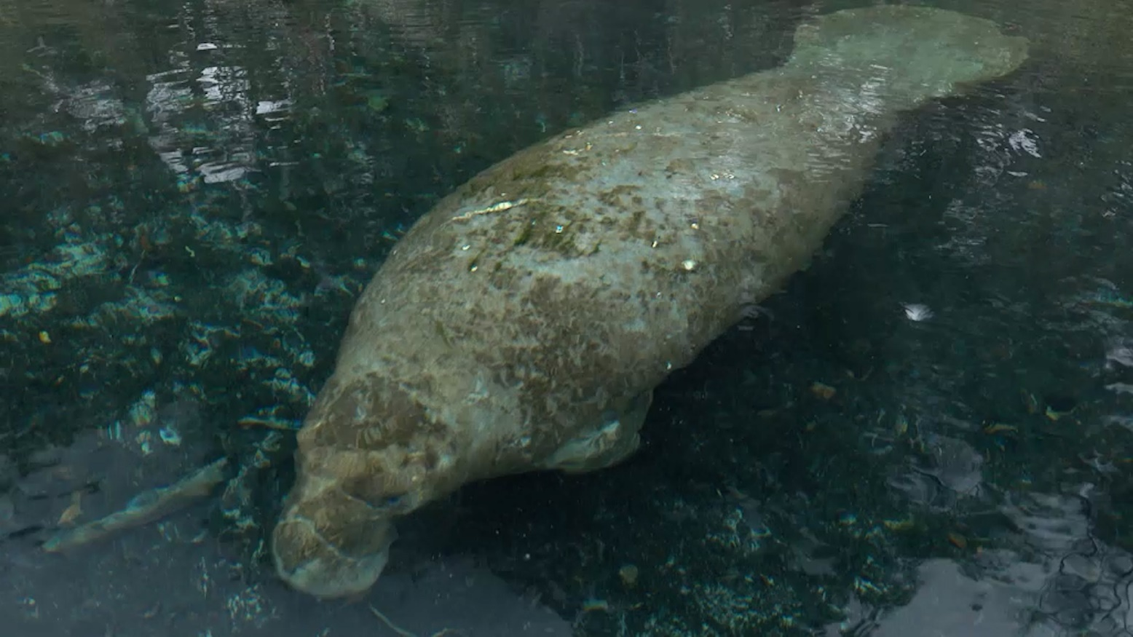
Description:
Florida manatees can grow to more than 9 feet long and weigh over 1,000 pounds, with the females typically growing slightly larger than the males.

Slide 9
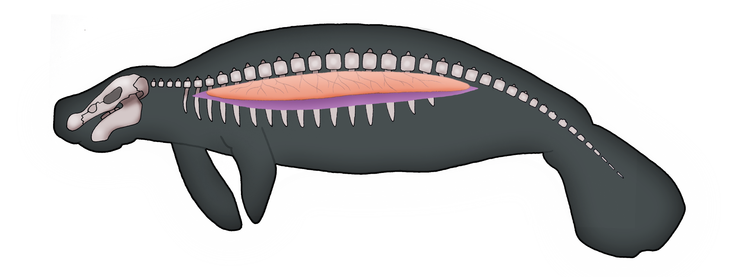
Manatee’s rib bones are incredibly dense. They act as ballast, allowing the animals to sink to the bottom. Also, they have elongated lungs and specially designed diaphragms. These features allow manatees to regulate their buoyancy through their breathing.

Slide 10
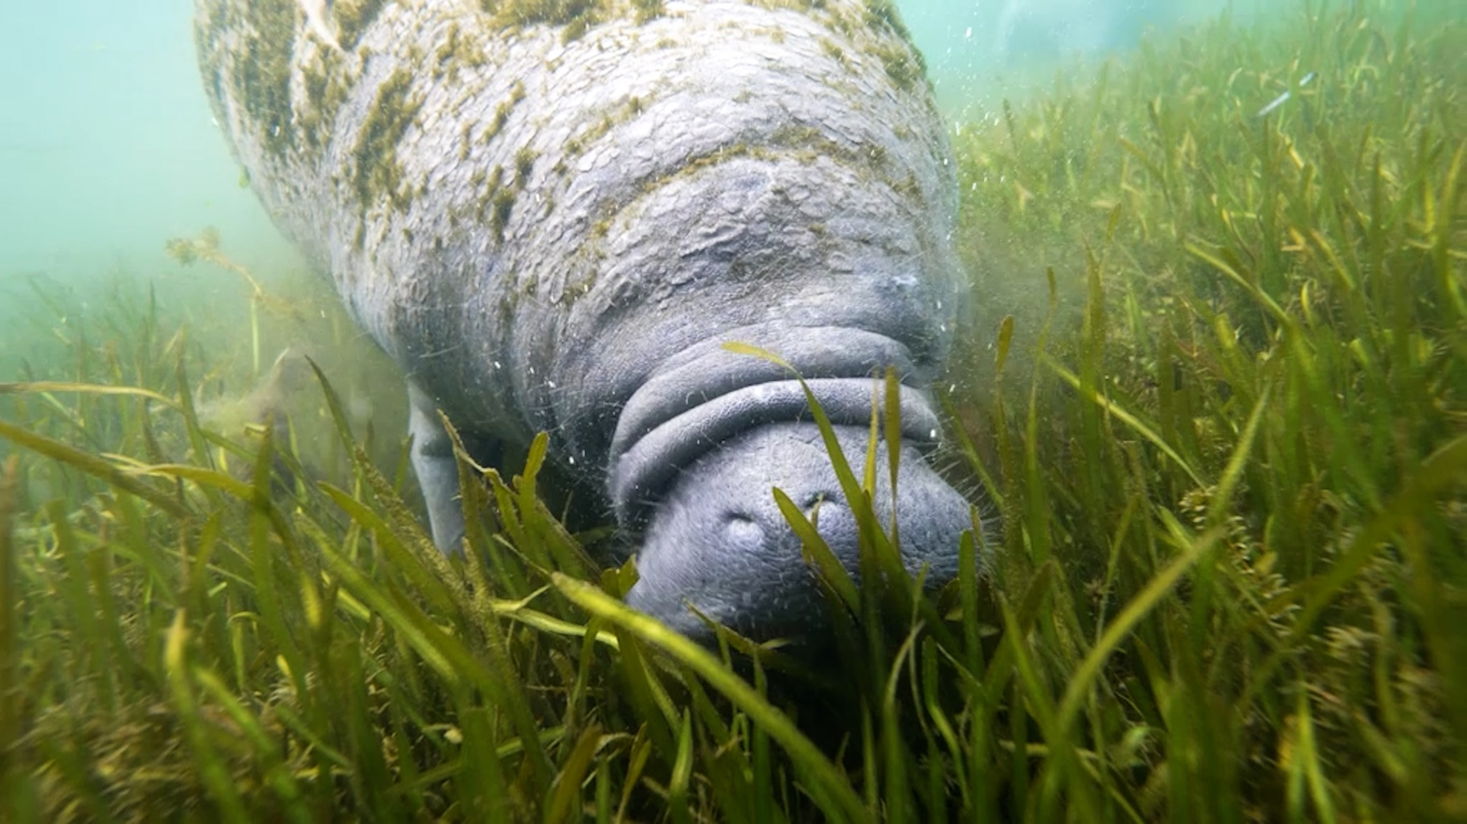
Diet:
Florida manatees are herbivores. They spend as much as 8 hours a day browsing and grazing on vegetation, consuming up to 10 percent of their body weight each day.

Slide 11
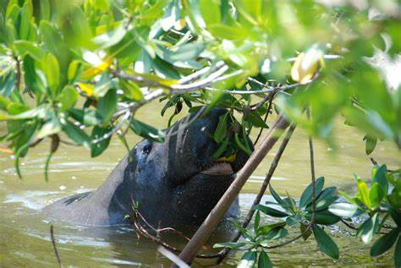
Their favorite foods are sea grasses and freshwater grasses such as eel grass. They will also eat other aquatic plants and even browse on overhanging leaves and twigs of trees such as the red mangrove.

Slide 12
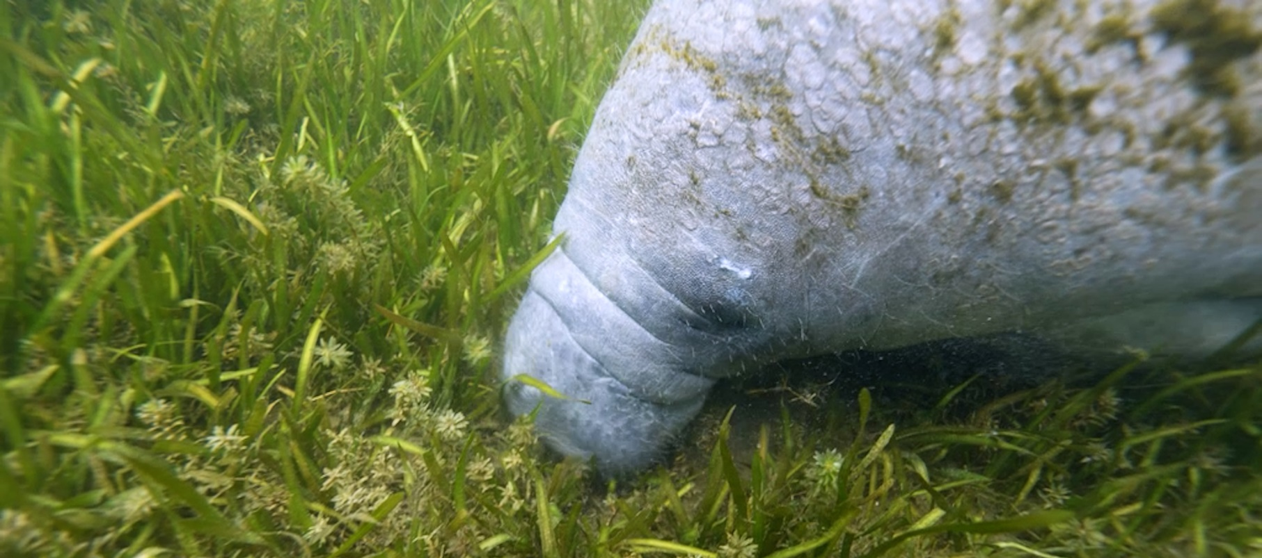
Habitats:
The Florida manatee is a tropical species and a herbivore that eats aquatic grasses. Not surprisingly, it prefers shallow, warm, coastal estuaries carpeted with seagrass.

Slide 13
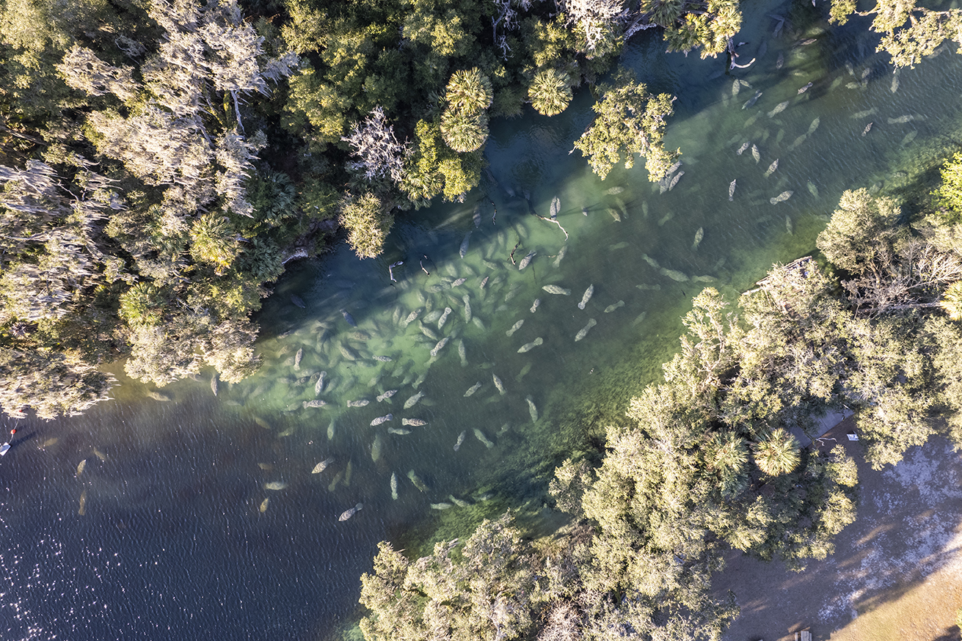
Manatees also don’t like being cold, and can’t survive sustained water temperatures below 68 degrees Fahrenheit.
During the winter months, they can find warm water refuges in Florida’s springs, where the water is 72 degrees regardless of the season.

Slide 14
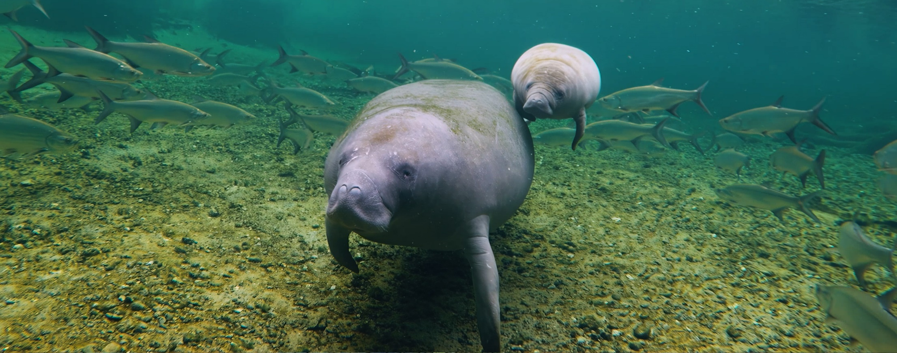
Threats:
Manatees have no natural predators. They’re just too big for sharks or alligators to mess with.

Slide 15
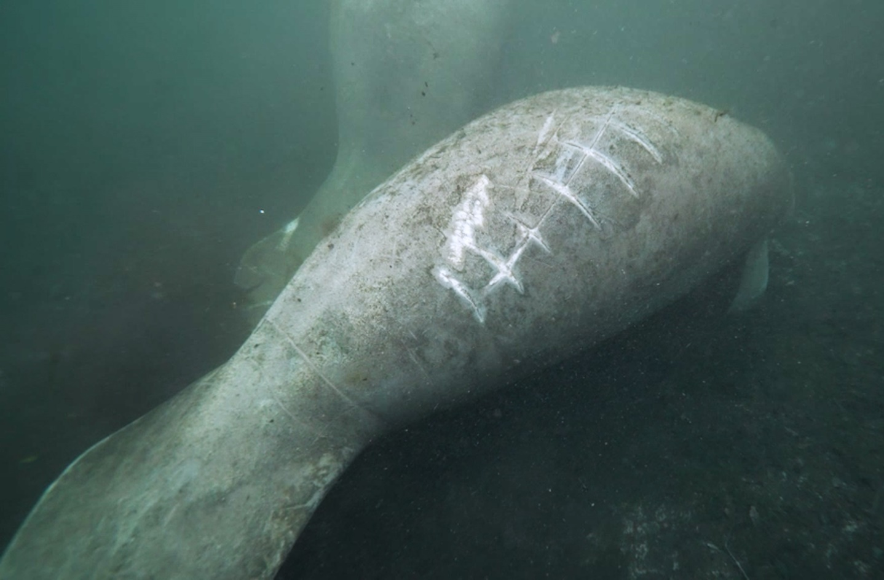
Today, one of the biggest threats these slow-moving mammals face, is from boat strikes.
Most manatees in Florida have prop-scars. Individuals can often be identified by their scar patterns.

Slide 16
But habitat loss is potentially their biggest threat.
The loss of important seagrass beds due to pollution and algae blooms lead to over 1,100 manatee deaths in 2021, mostly due to starvation.

Slide 17
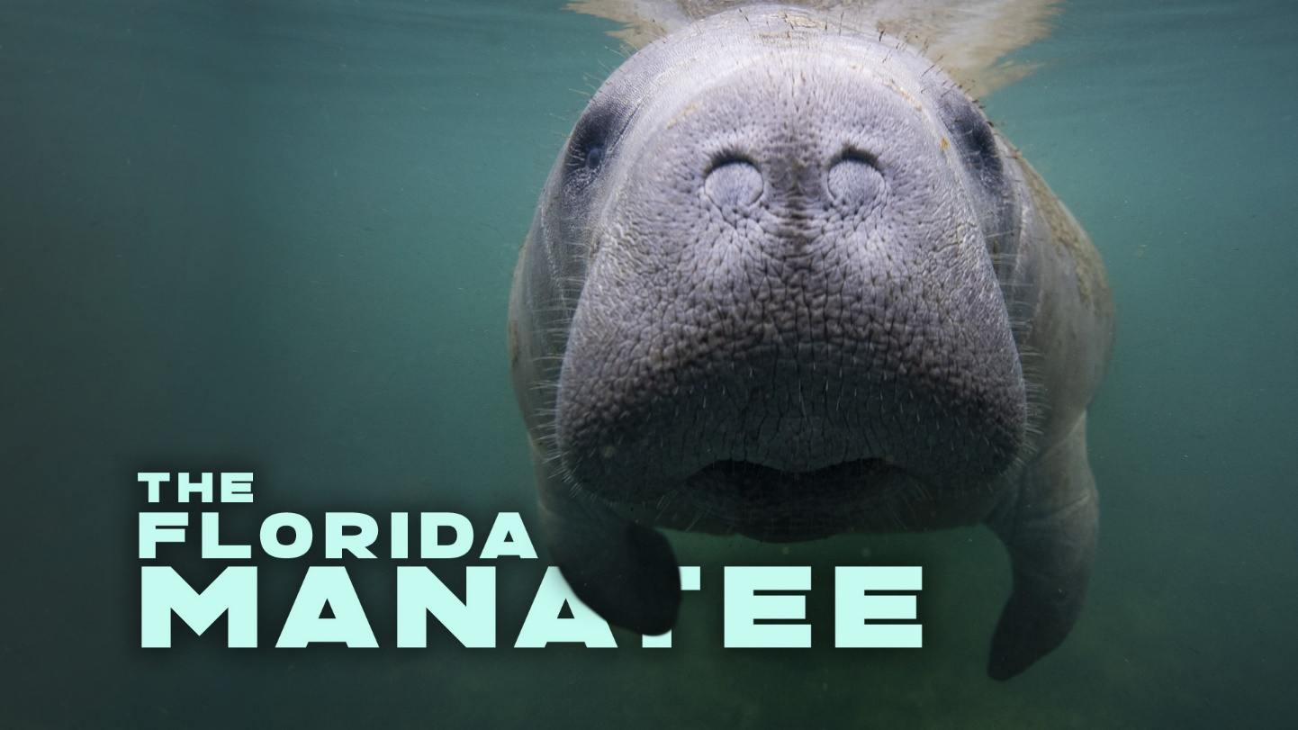
Video

Slide 18
Test Your Knowledge #1
Which of the following statements is not true about Florida manatees?
A. They are related to elephants.
B. They have no natural predators.
C. Crocodiles are a constant threat.

Slide 19
Test Your Knowledge #2
Which of the following statements is true about manatees?
A. They are carnivores.
B. Seagrass is their favorite food.
C. They prefer cold water.

Slide 20
Test Your Knowledge #3
Springs are important for manatees because:
A. They are warm-water refuges.
Alligators don’t live there.
C. They are cold-water refuges.

Slide 21
Quick Class Discussion Can the health of our manatee populations tell us something about the health of their habitats? If so, what does it tell us and why?

Slide 22
Students Need More ?
Instagram
Website

