Slide 1
Teacher’s Guide

Slide 2
Chapters
Islands of Diversity
Cuba’s Endemic Species
Zapata Swamp
Coral Reefs
Gardens of the Queen
Currents and Connections

Slide 3
Benchmarks
SC.K.L.14.3 Observe plants and animals, describe how they are alike and how they are different in the way they look and in the things they do
SC.K.N.1.2 Make observations of the natural world and know that they are descriptors collected using the five senses.
SC.1.E.6.2 Describe the need for water and how to be safe around water.
SC.1.L.17.1 Through observation, recognize that all plants and animals, including humans, need the basic necessities of air, water, food, and space.
SC.2.L.16.1 Observe and describe major stages in the life cycles of plants and animals, including beans and butterflies.
SC.2.L.17.2 Recognize and explain that living things are found all over Earth, but each is only able to live in habitats that meet its basic needs.
SC.3.L.14.1 Describe structures in plants and their roles in food production, support, water and nutrient transport, and reproduction.
SC.3.L.15.1 Classify animals into major groups (mammals, birds, reptiles, amphibians, fish, arthropods, vertebrates and invertebrates, those having live births and those which lay eggs) according to their physical characteristics and behaviors.
SC.4.E.6.1 Identify the three categories of rocks: igneous, (formed from molten rock); sedimentary (pieces of other rocks and fossilized organisms); and metamorphic (formed from heat and pressure).
SC.4.E.6.3 Recognize that humans need resources found on Earth and that these are either renewable or nonrenewable.
SC.4.L.16.1 Identify processes of sexual reproduction in flowering plants, including pollination, fertilization (seed production), seed dispersal, and germination.
SC.4.L.17.4 Recognize ways plants and animals, including humans, can impact the environment.
SC.5.E.7.2 Recognize that the ocean is an integral part of the water cycle and is connected to all of Earth's water reservoirs via evaporation and precipitation processes.
SC.5.L.15.1 Describe how, when the environment changes, differences between individuals allow some plants and animals to survive and reproduce while others die or move to new locations.
SC.5.L.17.1 Compare and contrast adaptations displayed by animals and plants that enable them to survive in different environments such as life cycles variations, animal behaviors and physical characteristics.
SC.6.E.6.1 Describe and give examples of ways in which Earth's surface is built up and torn down by physical and chemical weathering, erosion, and deposition.
SC.6.E.6.2 Recognize that there are a variety of different landforms on Earth's surface such as coastlines, dunes, rivers, mountains, glaciers, deltas, and lakes and relate these landforms as they apply to Florida.
SC.7.E.6.6 Identify the impact that humans have had on Earth, such as deforestation, urbanization, desertification, erosion, air and water quality, changing the flow of water.
SC.7.L.15.2 Explore the scientific theory of evolution by recognizing and explaining ways in which genetic variation and environmental factors contribute to evolution by natural selection and diversity of organisms.
SC.7.L.17.2 Compare and contrast the relationships among organisms such as mutualism, predation, parasitism, competition, and commensalism.
SC.7.L.17.3 Describe and investigate various limiting factors in the local ecosystem and their impact on native populations, including food, shelter, water, space, disease, parasitism, predation, and nesting sites.
Return to menu

Slide 4
SC.8.L.18.1 Describe and investigate the process of photosynthesis, such as the roles of light, carbon dioxide, water and chlorophyll; production of food; release of oxygen.
SC.912.E.7.2 Analyze the causes of the various kinds of surface and deep water motion within the oceans and their impacts on the transfer of energy between the poles and the equator.
SC.912.E.7.4 Summarize the conditions that contribute to the climate of a geographic area, including the relationships to lakes and oceans.
SC.912.E.7.9 Cite evidence that the ocean has had a significant influence on climate change by absorbing, storing, and moving heat, carbon, and water.
SC.912.L.15.9 Explain the role of reproductive isolation in the process of speciation.
SC.912.L.17.12 Discuss the political, social, and environmental consequences of sustainable use of land.
SC.912.L.17.14 Assess the need for adequate waste management strategies.
SC.912.L.17.16 Discuss the large-scale environmental impacts resulting from human activity, including waste spills, oil spills, runoff, greenhouse gases, ozone depletion, and surface and groundwater pollution.
SC.912.L.17.18 Describe how human population size and resource use relate to environmental quality.
SC.912.L.17.2 Explain the general distribution of life in aquatic systems as a function of chemistry, geography, light, depth, salinity, and temperature.
SC.912.L.17.3 Discuss how various oceanic and freshwater processes, such as currents, tides, and waves, affect the abundance of aquatic organisms.
SC.912.L.17.4 Describe changes in ecosystems resulting from seasonal variations, climate change and succession.
SC.912.L.17.6 Compare and contrast the relationships among organisms, including predation, parasitism, competition, commensalism, and mutualism.
SC.912.L.17.8 Recognize the consequences of the losses of biodiversity due to catastrophic events, climate changes, human activity, and the introduction of invasive, non-native species.

Slide 5
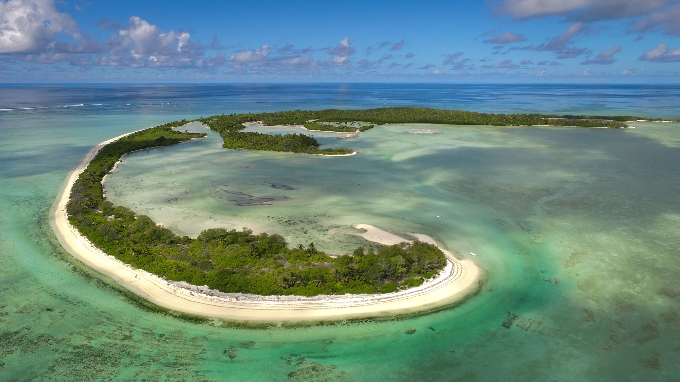
Islands of Diversity
Islands are in many ways defined by their isolation. Surrounded by water, these landmasses are separated from larger continents. This isolation promotes evolutionary processes that often result in communities rich with endemic plants and animals.

Slide 6
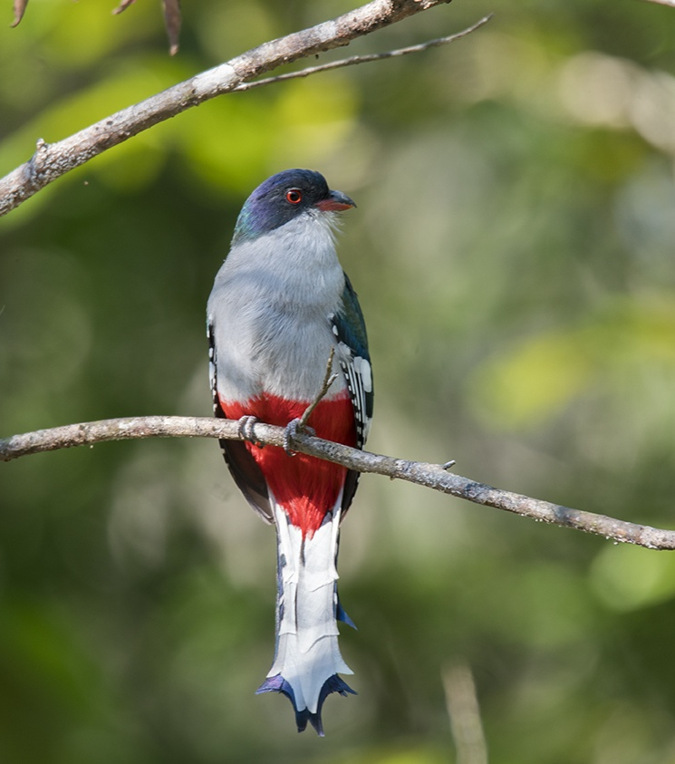
Endemic Species- plants and animals that exist only in one geographic region.
Islands usually have much higher percentages of endemic species than nearby continents. Famous examples are the Galapagos Islands where 97 percent of its land mammals and reptiles are endemic, and Madagascar, home to more than 8000 endemic plants and animals.
This is why islands are considered to be biodiversity hotspots.
Cuban trogon

Slide 7
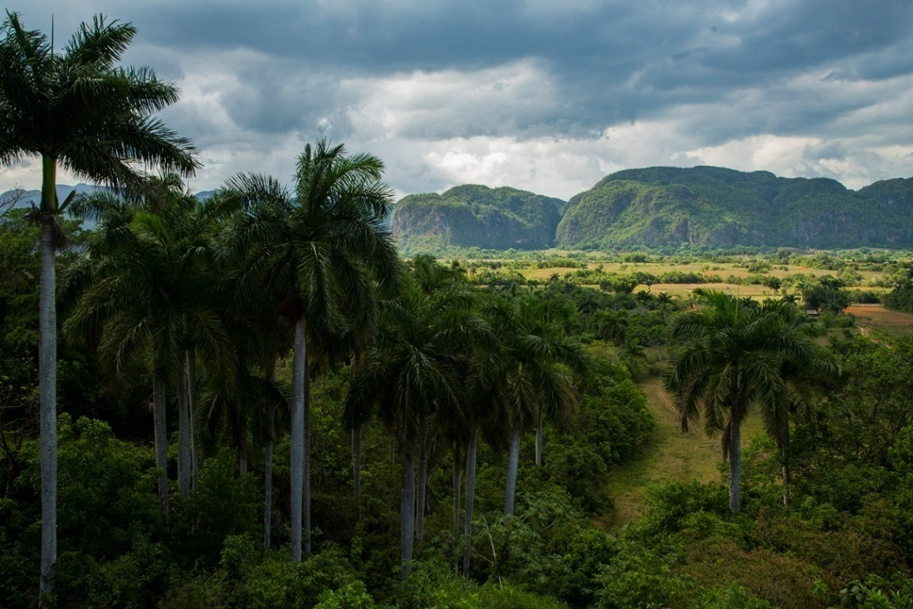
Biodiversity- refers to the variety and variability of life on Earth
Vinales Valley, Cuba
The island of Cuba is also famous for its unique flora and fauna. As much as half of its plant species, and one third of its vertebrates are found nowhere else in the world.

Slide 8
Quiz #1
Which of the following statements is true about islands?
A. They are usually known for low levels of biodiversity
B. They all have tropical climates
C. They typically have high percentages of endemic species
Which best defines the term “biodiversity?”
A. Refers to the total population of an individual species
B. Refers to the variety and variability of life on Earth
C. Describes an animal community with very few predators
The Galapagos Islands have very few endemic species
True
False
Return to menu

Slide 9
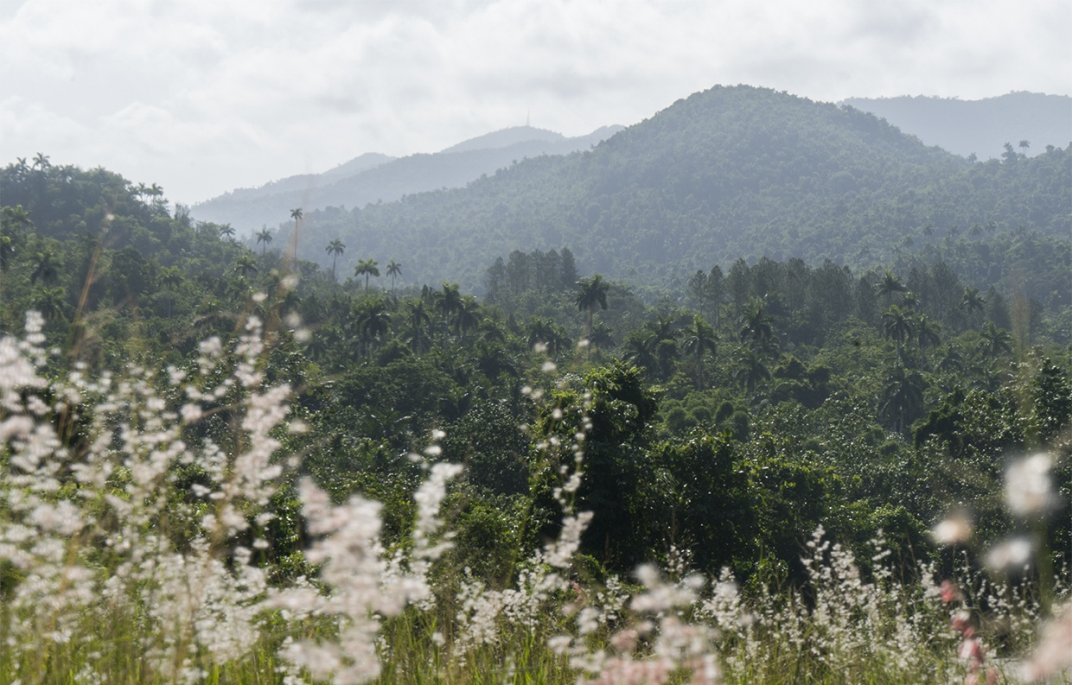
Cuba’s Endemic Species
Sierra de los Órganos, Cuba
Cuba is home to more than 3000 species of plants that are endemic to the island.
This includes several varieties of palm trees, and as many as 300 endemic orchid species.

Slide 10
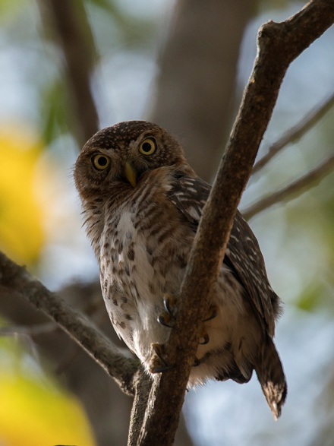
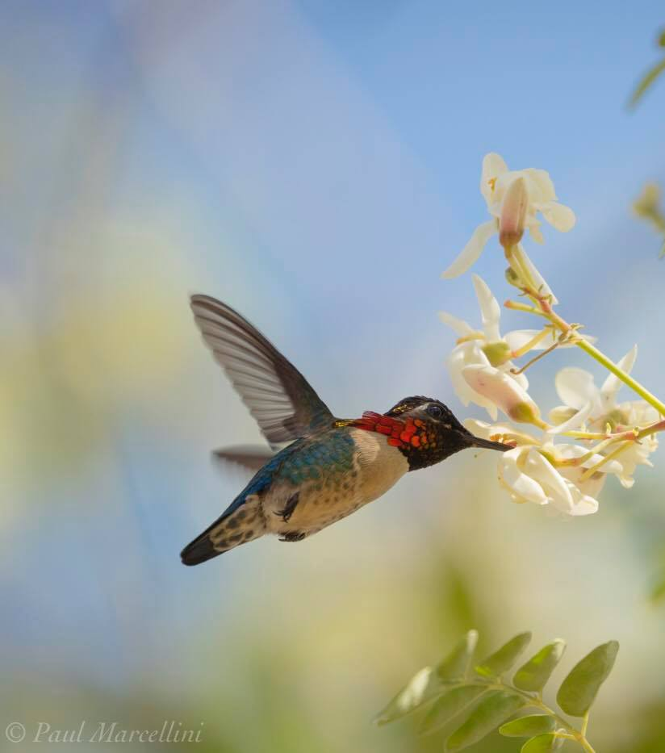
Birds (most, at least) can fly so understandably, most of Cuba’s 376 birds are not endemic.
27 species, however, are unique to the island.
Cuban trogon
Cuban tody
Cuban pygmy owl
Bee hummingbird

Slide 11
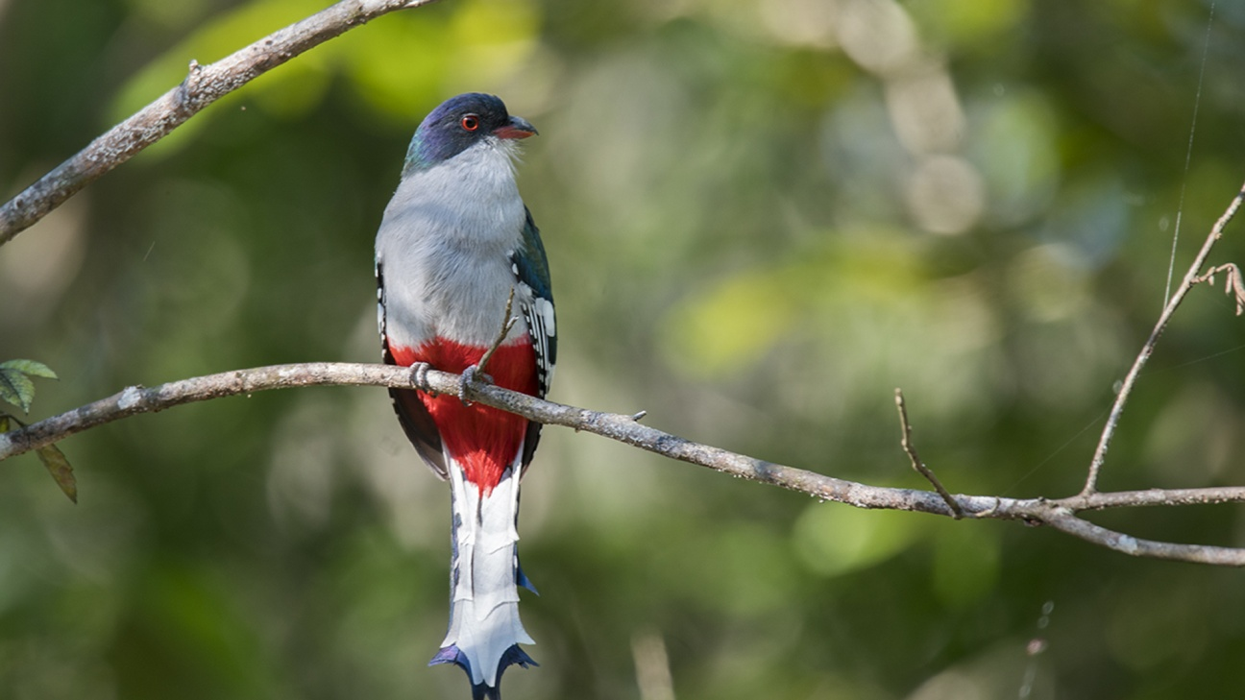
The Birds of Cuba
Video Exploration

Slide 12
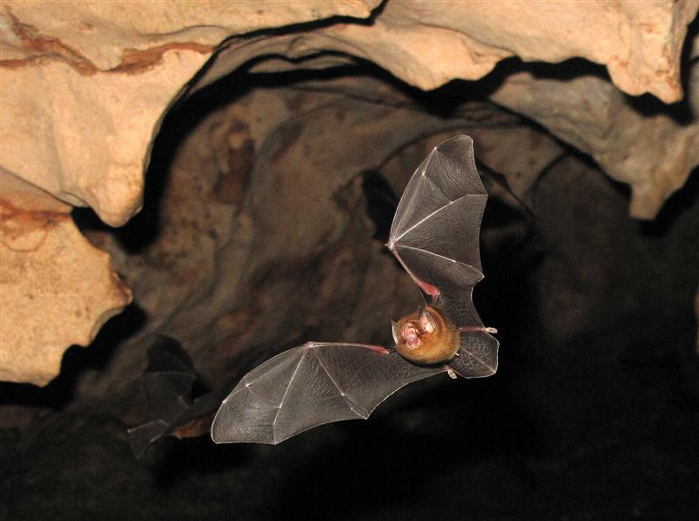
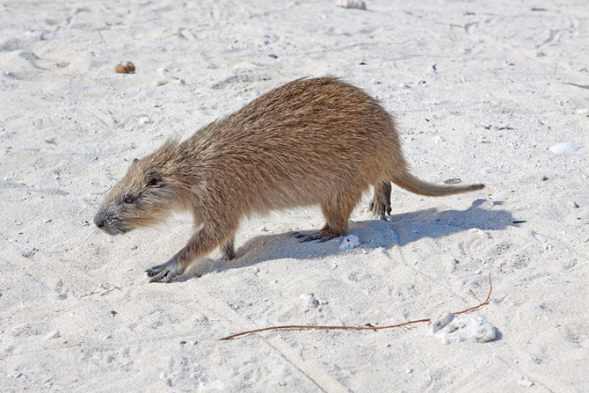
Cuba has fewer than 40 species of mammals, ¾ of which are bats. The butterfly bat is an endemic species and is considered to be one of the world’s smallest species of bat.
We also find several species of hutias, sometimes called “tree rats.” Hutias, like this endemic Cuban hutia are swiftly disappearing, often hunted for their meat.

Slide 13
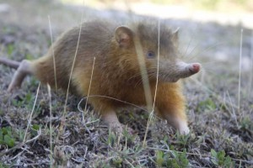
The solenodon is perhaps the strangest of all of Cuba’s endemic mammals.
This large, shrew-like creature has venomous saliva.
It is also an ancient species, very closely resembling an ancestor that existed alongside dinosaurs.
Today, the Cuban solenodon is critically endangered.

Slide 14
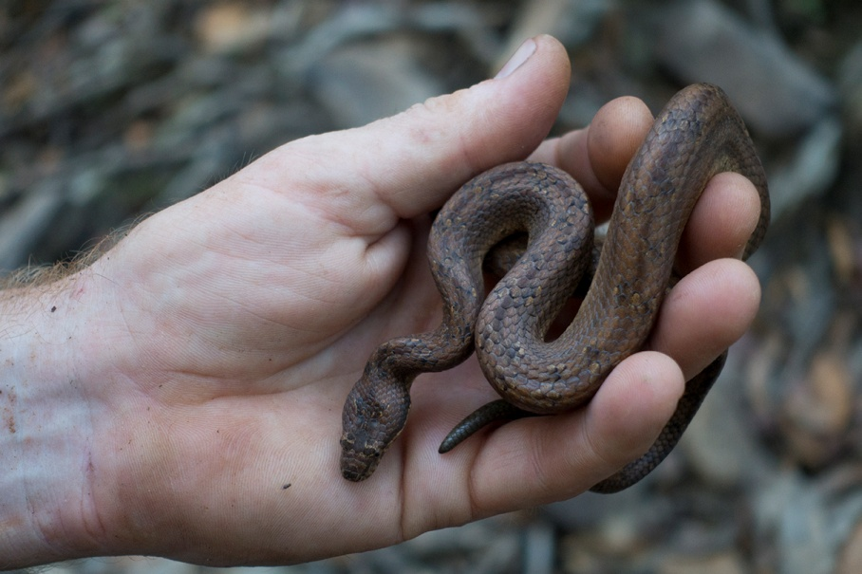
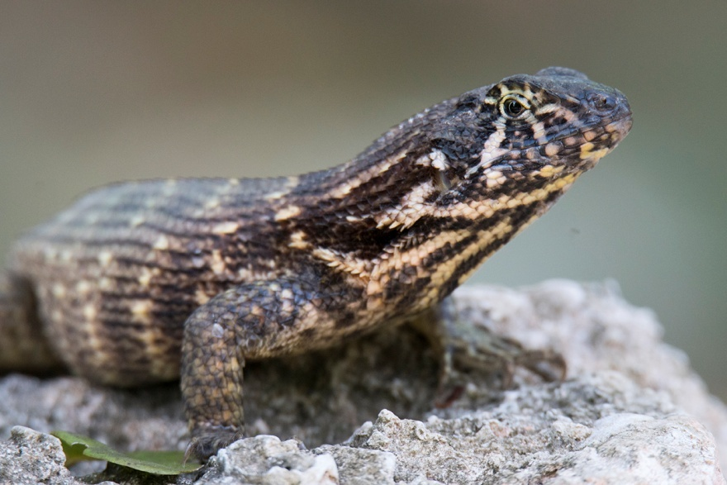
While mammals are few, reptiles are plentiful in Cuba. They include several species of endemic snakes, like this dusky pygmy boa.
Lizards are also very common, like this saw scaled curly-tailed lizard.

Slide 15
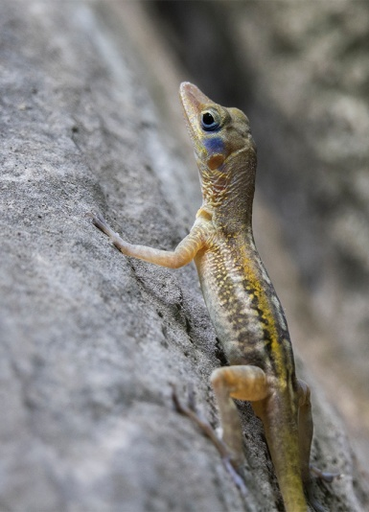
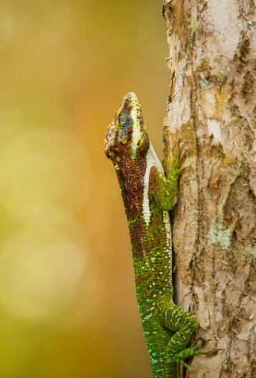
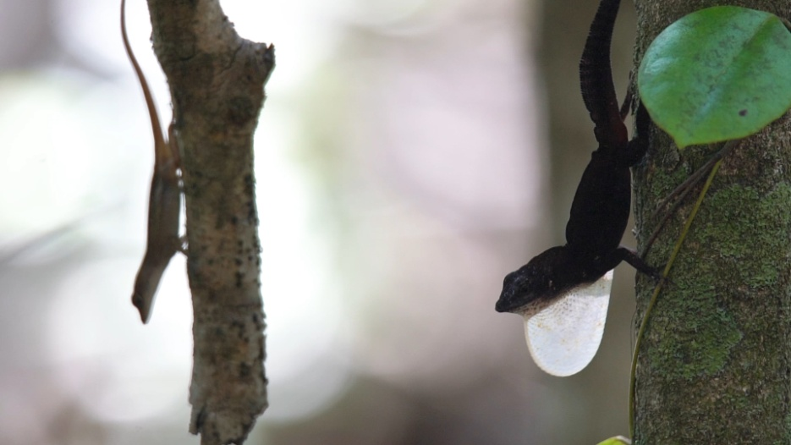
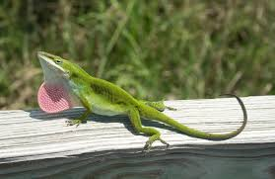
Cuba is home to more than 60 species of lizards from the genus Anolis, most of which are endemic.
By comparison, Florida only has one native species: Anolis carolinensis

Slide 16
In Florida there are several species of lizards that have been introduced from other parts of the Caribbean, South America, Africa or Asia. These are called exotic species.
Many of these came here through the pet trade, were released and in some cases they displace the native species or cause damage to the native ecosystem. We call these invasive species
Exotic Species- species of plants or animals that are growing in a nonnative environment
Invasive Species- a species that is non-native to the ecosystem and whose introduction causes or is likely to cause economic or environmental harm or harm to human health

Slide 17
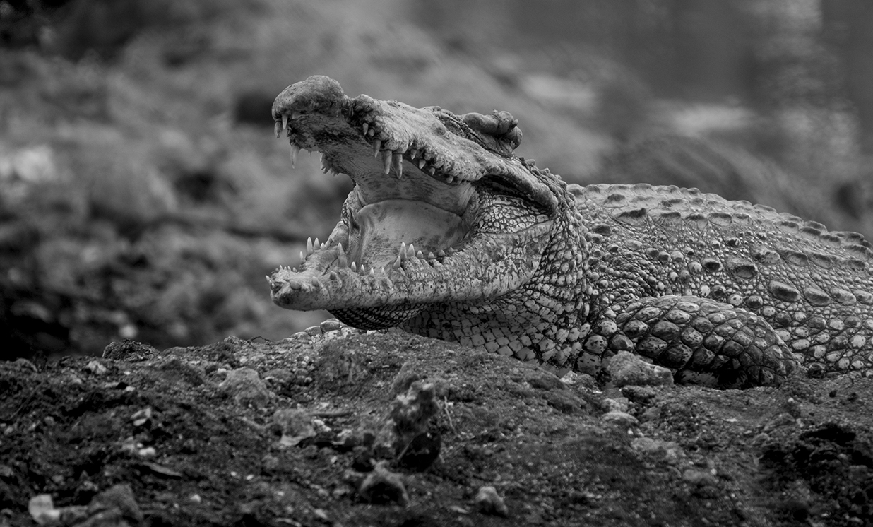
Cuba’s most famous reptile is the Cuban crocodile. This feisty crocodile is only found in two wetland areas in Cuba: Zapata Swamp and Lanier Swamp on Isla de Juventud.
In certain areas of Zapata Swamp, they share habitat with American Crocodiles. It is now known that the two species are beginning to interbreed. This could be bad for the survival of the Cuban crocodile, which numbers about 2,500 in the wild.

Slide 18
Quiz #2
Which of the following statements is true about invasive species?
A. They cause little to no damage to native species
B. They often displace native species
C. They usually disappear on their own
Approximately ______ species of plants are endemic to Cuba.
A. 300
B. 3000
C. 1500
Which of the following is not true of the Cuban solenodon?
A. It is a mammal related to the shrew
B. It has venomous saliva
C. It is common throughout Cuba
Return to menu

Slide 19
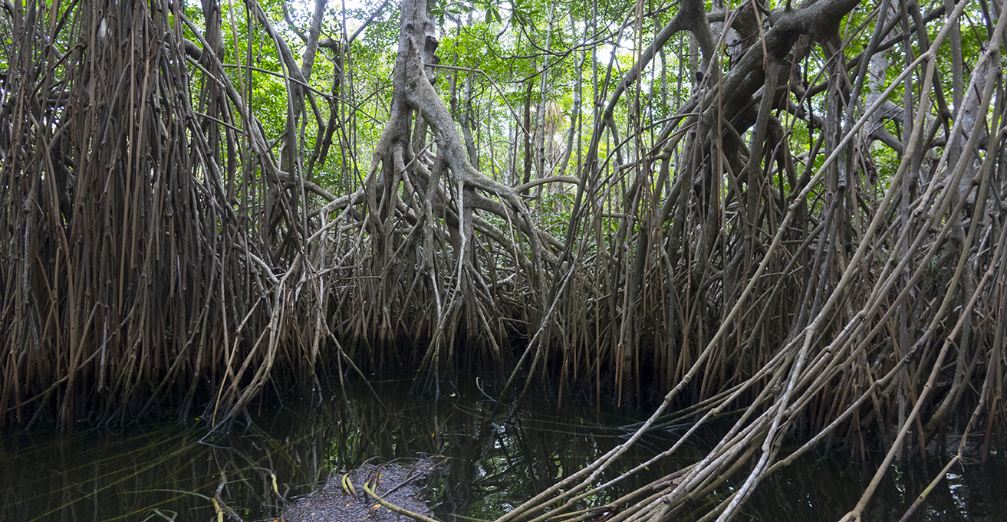
Zapata Swamp
Cienega de Zapata, or “Zapata Swamp,” is found in southwestern Cuba, on the shoe-shaped Zapata Peninsula. It is part of the Gran Parque Natural Montemar Biosphere Reserve which was declared a UNESCO Biosphere Reserve in 2001.

Slide 20
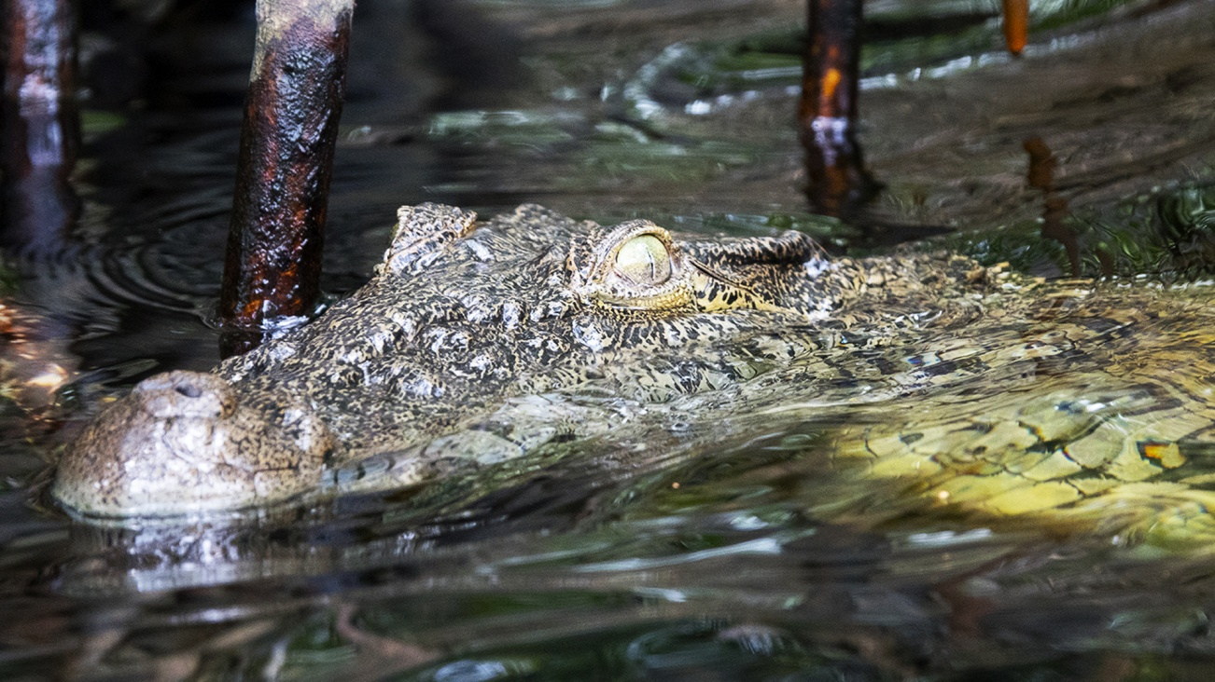
Exploring Zapata Swamp
Video Exploration

Slide 21
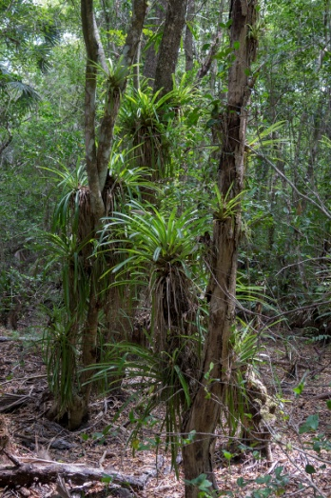
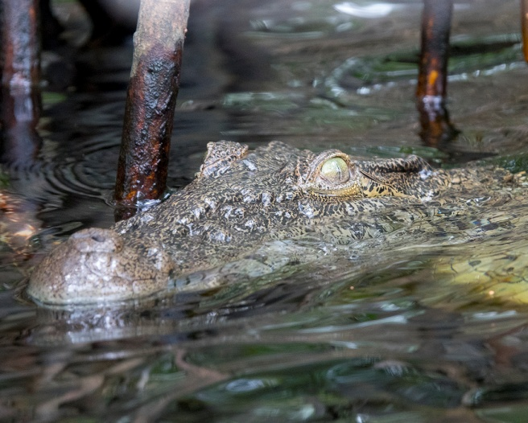
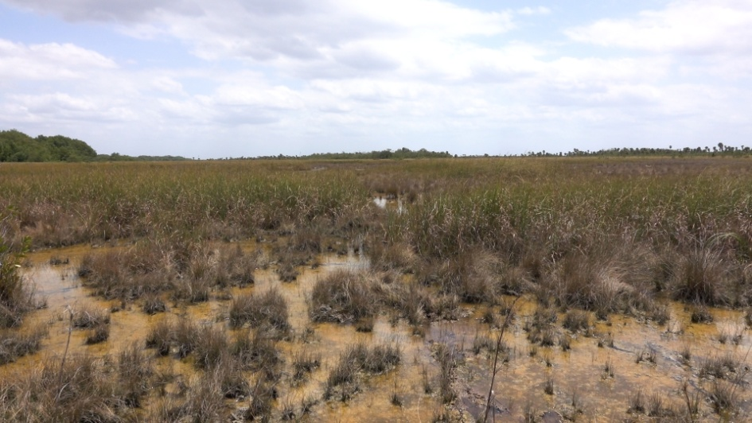
Zapata Swamp covers over 1 million acres, making it the largest wetland in the Caribbean and one of the most important natural areas in Cuba.
It is often called “Cuba’s Everglades, and shares many similarities with the Everglades, such as sawgrass prairies, and mangrove swamps. Still, it is a very unique ecosystem.
Forest coverage in Zapata Swamp accounts for 15% of the forest coverage of the entire island of Cuba. To put it into perspective, it contains more forest area than is found in all of Jamaica!

Slide 22
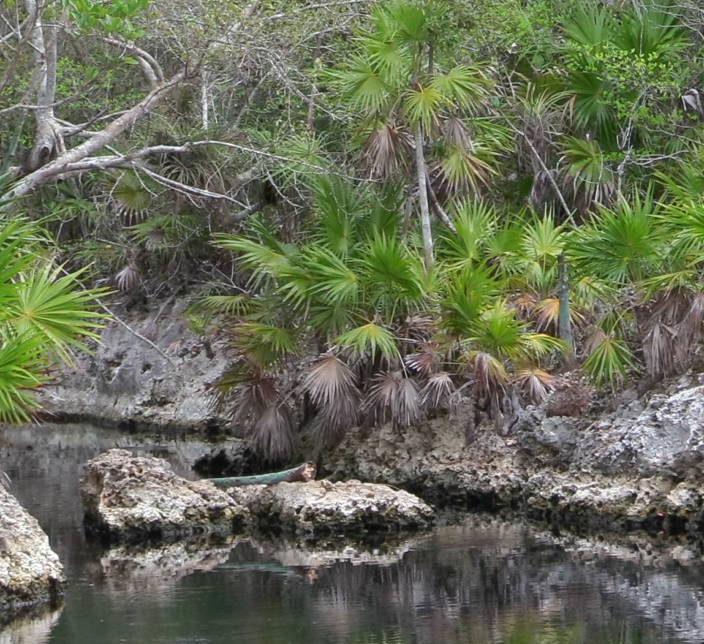
The foundation of the Zapata Peninsula is one of limestone.
Limestone- a sedimentary rock composed of crystallized calcium carbonate (CaCO3).
The limestone of the Zapata Peninsula is basically made up of ancient coral and other marine organisms. When organic materials like fallen leaves mix with fresh water, that water becomes slightly acidic.
Over time that acidic water has dissolved the limestone floor of the Zapata Peninsula into a swiss cheese network of solution holes and caves.
This jagged limestone can be seen all over the Peninsula and along the coast and in Cuba it is referred to as “Diente de Perro,” or “Tooth of the Dog.”

Slide 23
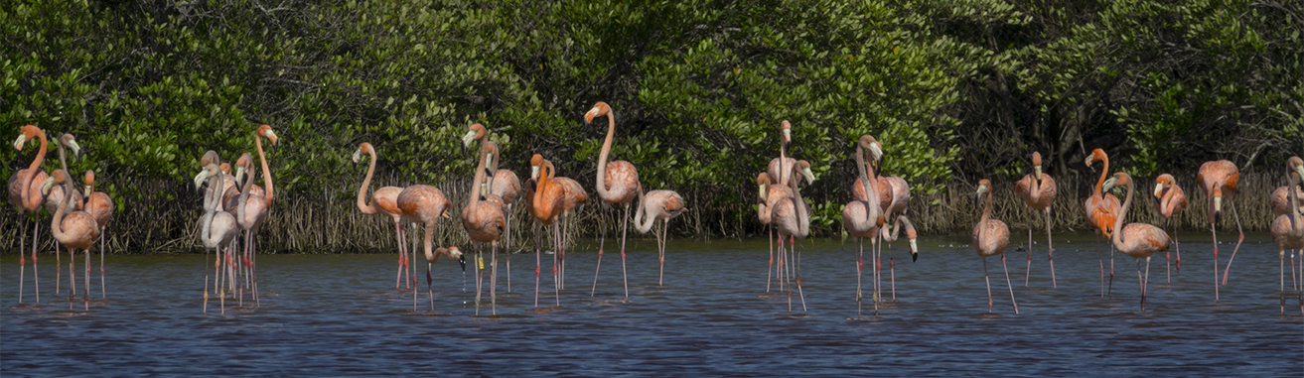
The limestone foundation acts like a giant sponge, allowing fresh water from the mainland of Cuba to flow through it.
In the coastal areas, such as Las Salinas on the southeastern part of the Zapata Peninsula, that fresh water mixes with salt water from the sea, creating brackish estuaries that are important nursery grounds for certain species of fish, as well as feeding grounds for fish species like bonefish and wading birds like Caribbean flamingos.

Slide 24
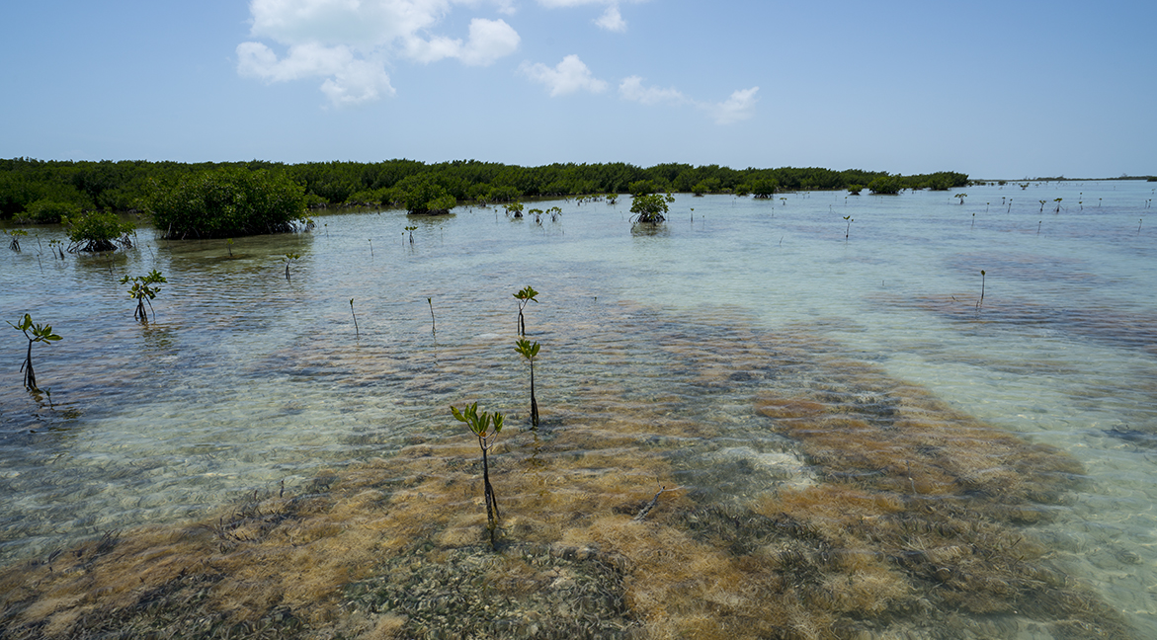
Brackish- water that has more salinity (salt content) than fresh water, but not as much as seawater. It may result from mixing of seawater with fresh water, as in estuaries
Estuary- a partially enclosed coastal body of brackish water with one or more rivers or streams flowing into it, and with a free connection to the open sea. Estuaries form a transition zone between river environments and maritime environments.

Slide 25
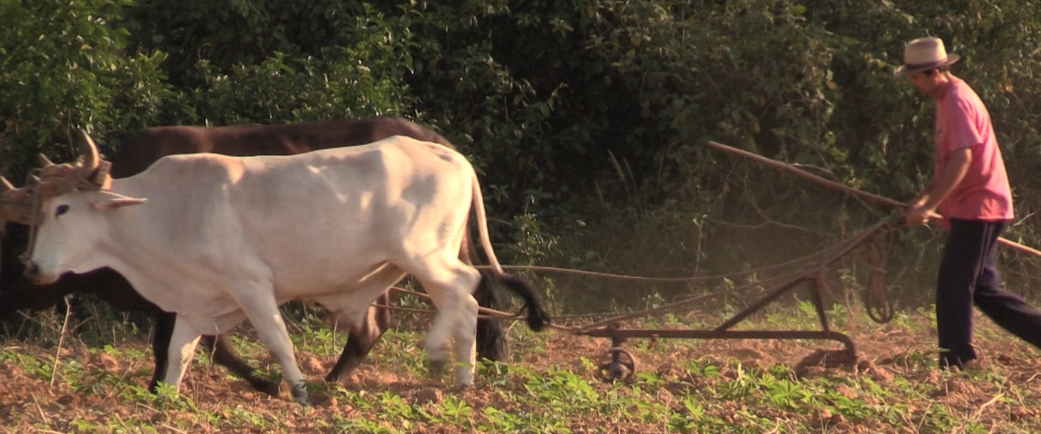
Like The Everglades, Zapata Swamp faces many threats. To the north, some of the fresh water that should be flowing into the system has been diverted for agricultural use.
Deforestation for agriculture as well as for charcoal production is also a serious problem.
Poaching is also a great concern. Sources of protein are limited in Cuba. Because of this, hutias, manatees and Cuban crocodiles are among several species of endangered animals that are being harvested illegally for their meat.

Slide 26
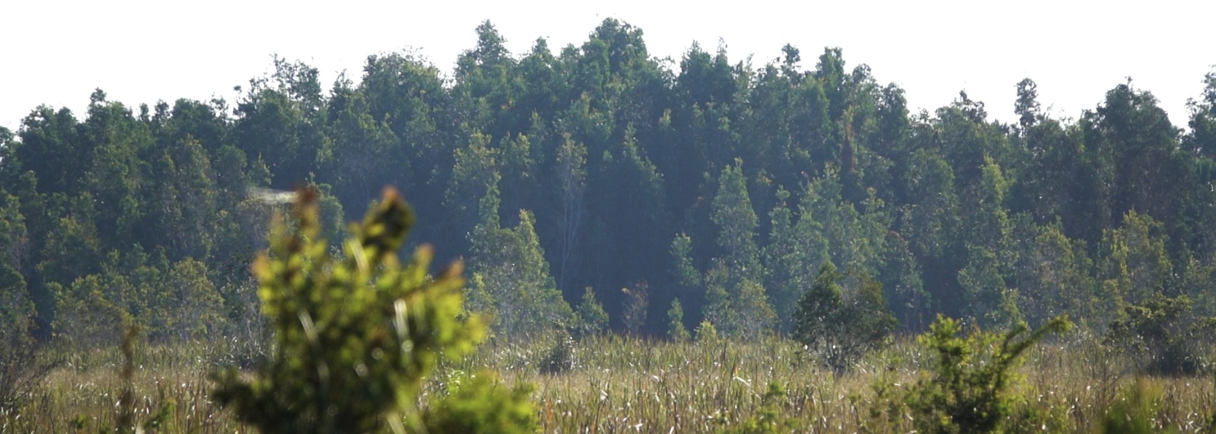
Zapata Swamp also has a growing problem with invasive animals and plants.
Perhaps the biggest threat is the spread of the melaleuca tree. The malaleuca was introduced from Australia decades ago. It is very fast growing and in Zapata as well as in the Everglades, there are no native pests to control their spread. These trees quickly spread in thick groves, sucking the water out of the wetland areas they invade and displacing native plants.

Slide 27
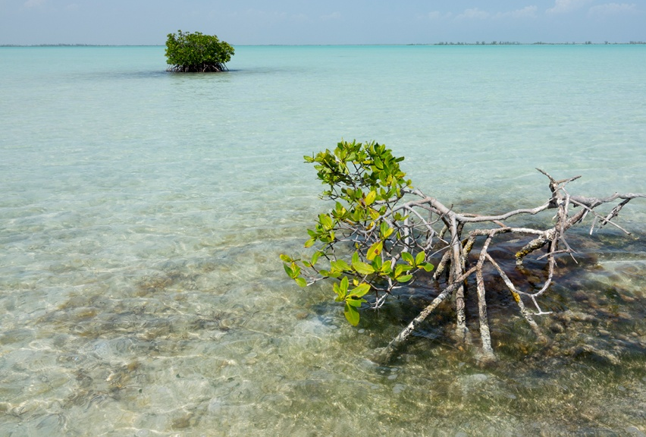
Climate change is another big concern for the future of Zapata Swamp. Global ocean temperatures are rising and glaciers and polar ice-caps are melting at accelerated rates. Unless this trend is stopped, sea-levels will continue to rise.
The Zapata Peninsula is a vast area that is low in elevation. Just a couple of feet of sea-level rise will mean that large areas of Zapata Swamp will be claimed by the sea and endangered species like the Cuban crocodile or the Cuban gar could face extinction.

Slide 28
Quiz #3
Zapata Swamp is the ________ wetland in the Caribbean.
A. Third largest
B. Largest
C. Smallest
Which of the following statements is not true about Zapata Swamp?
A. It is often called “Cuba’s Everglades”
B. It is one of the only ecosystems in which the Cuban Crocodile can be
found
C. It has been protected from invasive species
Climate change is not a threat to Zapata Swamp.
True
False
Return to menu

Slide 29
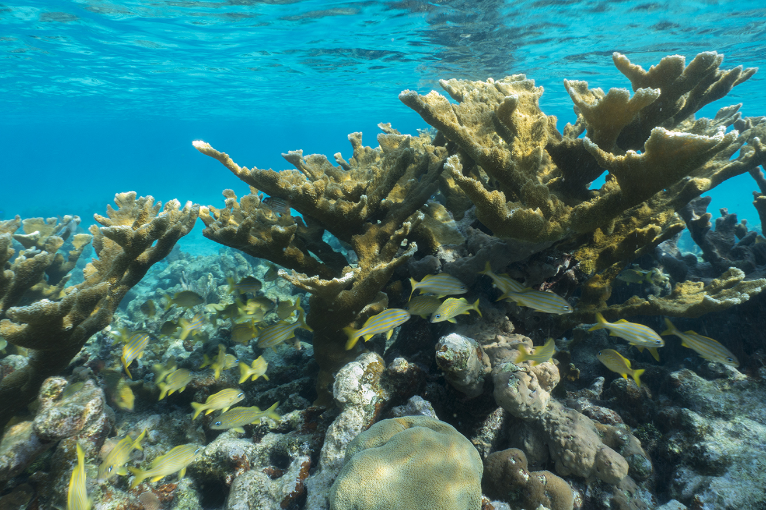
Coral Reefs
Cuba is home to some exceptionally healthy coral reefs. This is especially important now that the world’s coral reefs are in big trouble…but more on that in a bit.

Slide 30
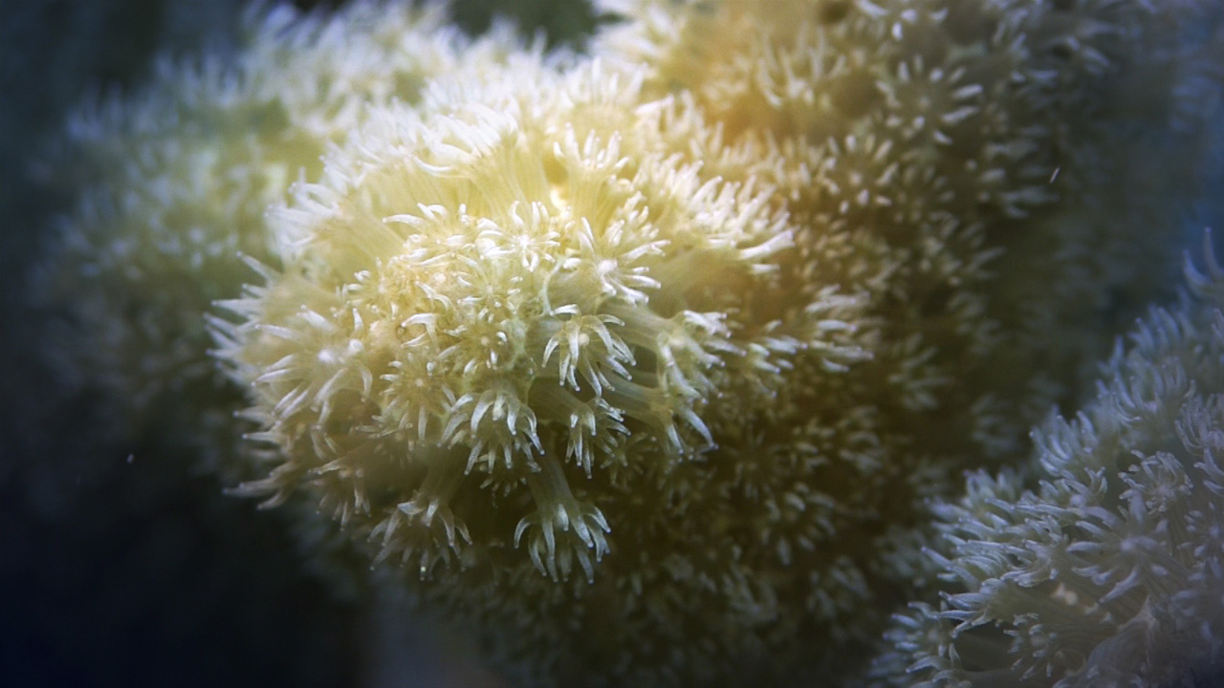
The Coral Reef Habitat
Video Exploration

Slide 31
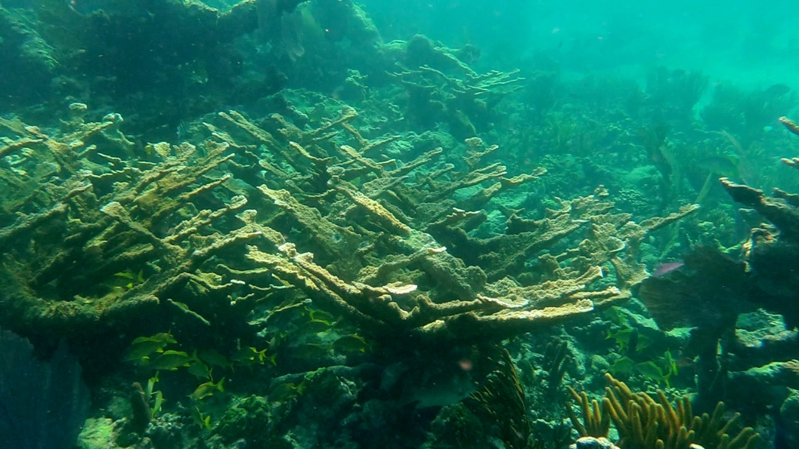
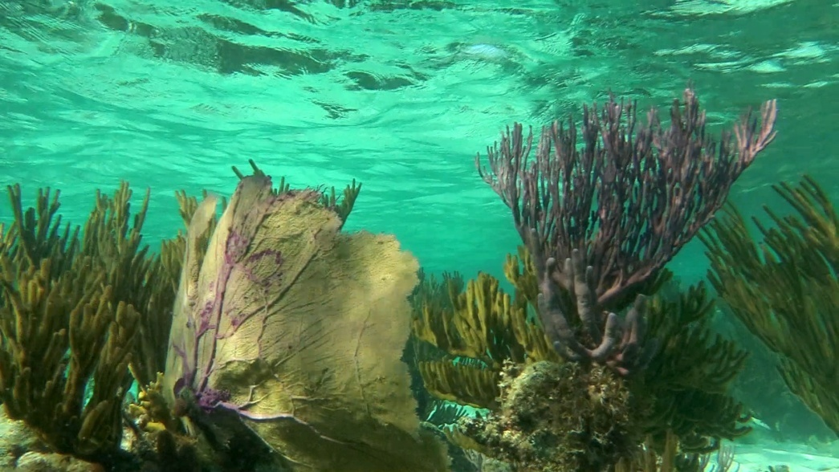
Coral reefs are often called the “rainforests” of the sea because they hold an amazingly diverse community of life.
Although coral reefs account for only about 0.1% of the ocean’s surface, they are home to about 25% of all marine species.
One of the main reasons for this is the intricate structures that hard corals create, which become shelter and attachment points for marine life.

Slide 32
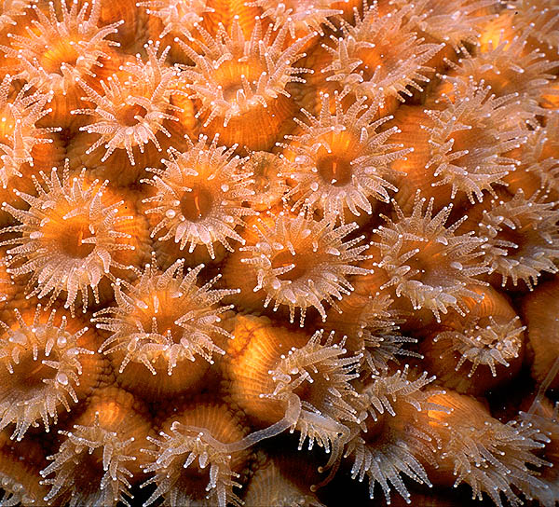
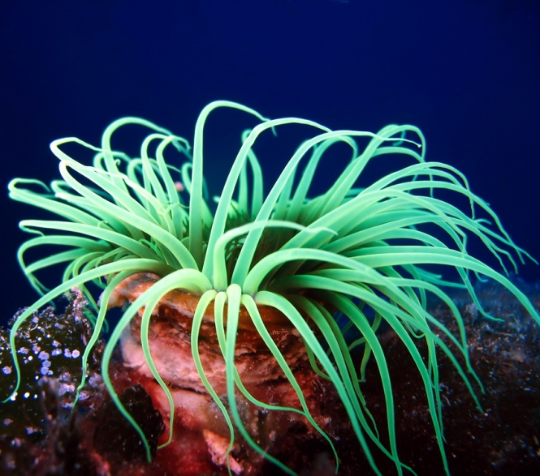
So what is a coral, exactly? That can be a bit confusing. You might wonder if a coral is a mineral, a vegetable, or an animal. The answer (sort of) is all three!
Most accurately, however, a coral is indeed an animal. The individual coral animal is a simple organism referred to as a “polyp.”
Corals are members of the phylum Cnidaria, which also includes jellyfish and anemones. If you look closely, you can see the resemblance.

Slide 33
Coral polyp- an individual coral animal
In very basic terms, coral polyps consist of a simple mouth structure ringed by tentacles that fire stinging cells to subdue planktonic animals.
Amazingly, however, most corals get the bulk of their nutrition from algal cells that live within their tissues. These algal cells create food for themselves through photosynthesis, and excess food energy is passed along to the coral polyp that hosts them. This is an incredible example of mutualism.
Mutualism- a symbiotic relationship between two organisms of different species in which each individual benefits

Slide 34
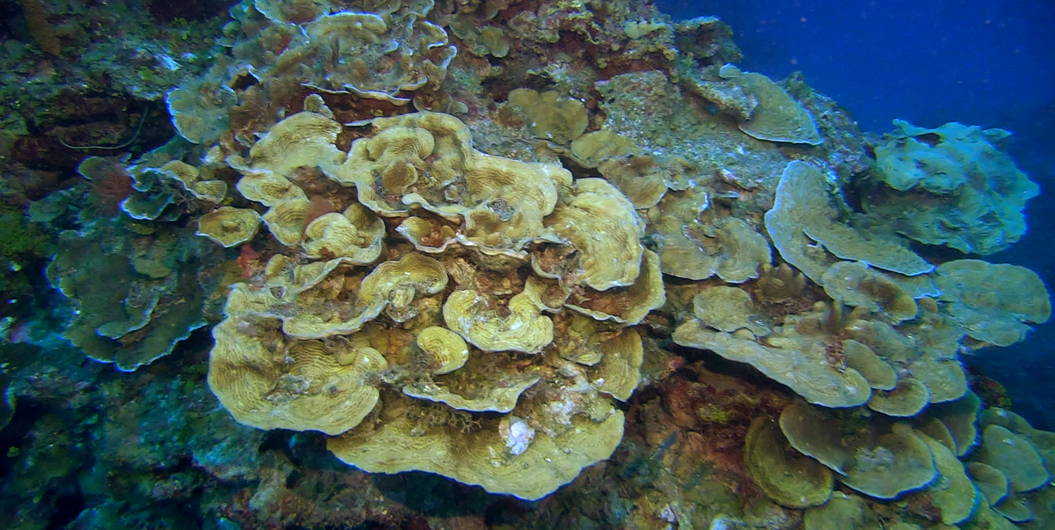
Hard corals are the architects of the oceans. The intricate stony structures that coral reefs are famous for are built by millions of tiny coral polyps. Each polyp secretes a stony exoskeleton that protects its soft body.
The polyps themselves reproduce asexually by “budding” or dividing and as they continue to create their exoskeletons, the stony structure grows. In fact a coral colony is made up of hundreds or thousands of individual polyps that are genetically identical.

Slide 35
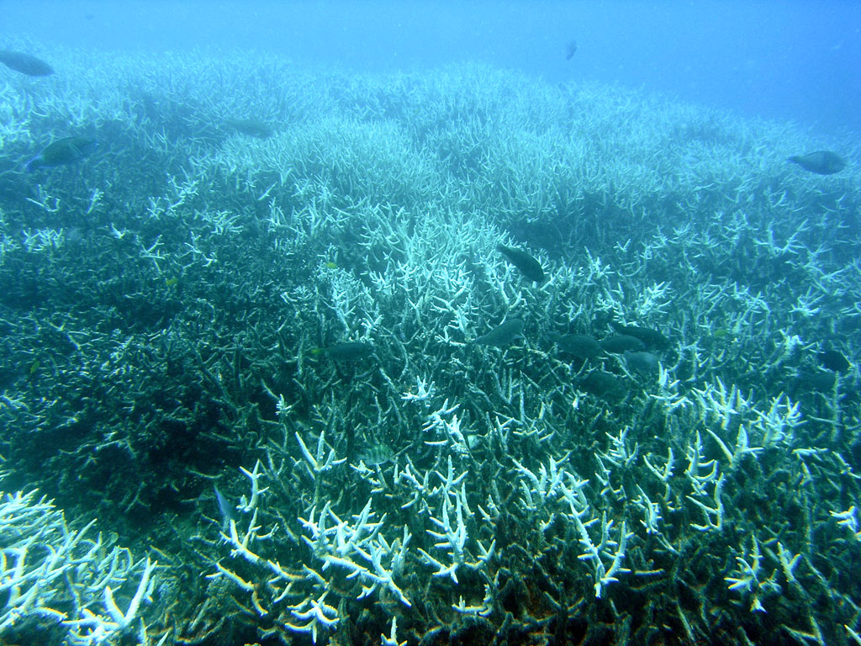
Today, the world’s corals are facing many threats. One threat in particular has decimated coral reefs around the world in recent years: Coral Bleaching. Coral polyps are clear, and they get their color from the algae that live within their tissues.
Coral bleaching occurs when coral polyps expel the algae in response to stress. The corals become white (the color of the calcium carbonate exoskeleton). The polyps no longer get the essential food-energy from the algae and will often die.
Coral bleaching events are becoming more and more frequent due to rising ocean temperatures. When ocean temperatures spike, massive bleaching and die-off events can turn a once thriving reef community into a lifeless field of rubble.
Today it is estimated that 19% of the world’s corals are already dead and some estimates suggest we could lose as much as 90% by 2050.

Slide 36
Quiz #4
Which of the following statements is not true about corals?
A. They have tentacles with stinging cells.
B. Corals are not living animals
C. They have polyp shaped bodies.
Which of the following statements is true about coral reefs?
A. They are home to as much as 25 percent of the ocean’s fish
B. The world’s coral reefs are expected to grow rapidly over the next decade
C. Coral reefs are immune to man-made pollution and global warming
The term “coral bleaching” refers to:
A. Pollution of coral reefs due to accidental spills of chemical bleach
B. Corals that have lost their color, having lost the algae that lives within their
tissues.
C. Corals that have recently died leaving only their skeletons.
Return to menu

Slide 37
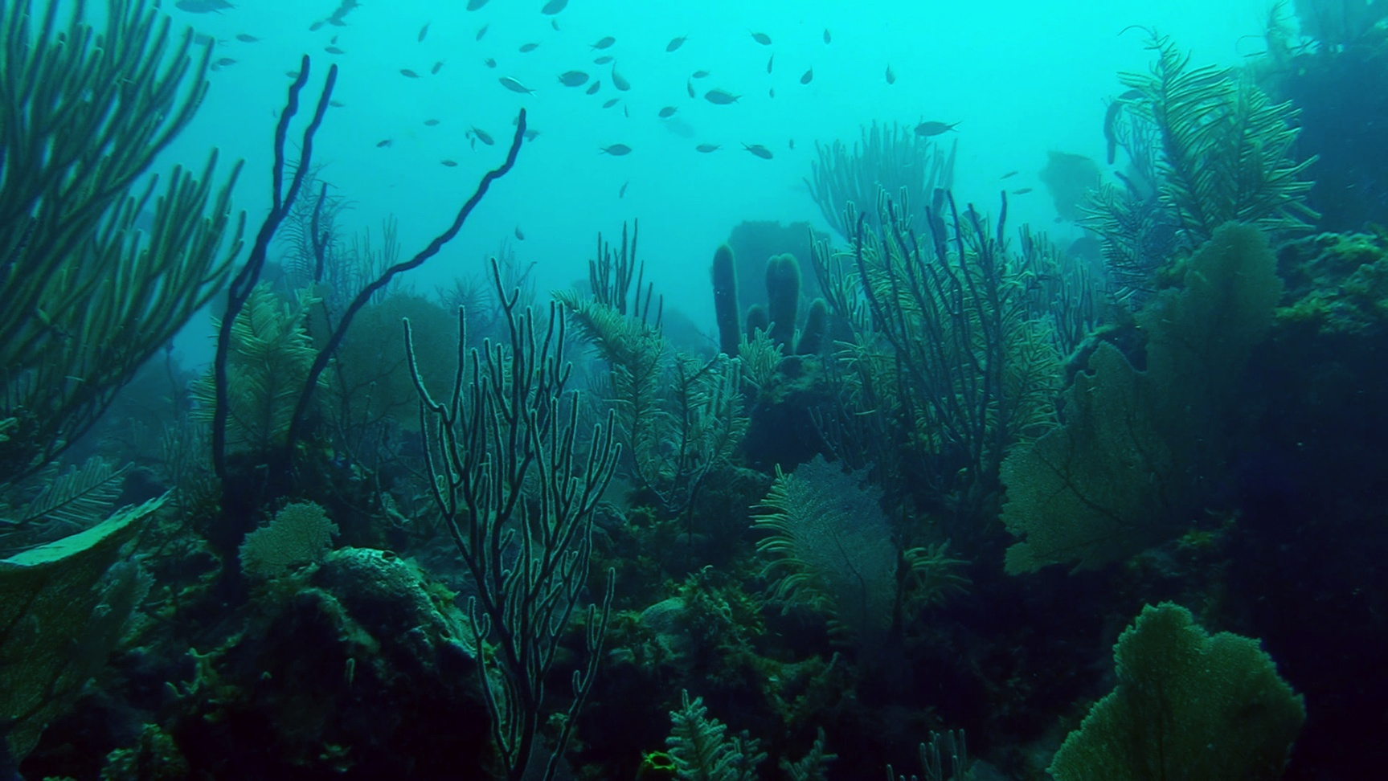
The Gardens of the Queen
One of the most spectacular natural places in Cuba is an archipelago that runs along the southern coast of Cuba. “Jardines de la Reina,” or “The Gardens of the Queen,” was named by Christopher Columbus in honor of the Queen of Spain. It is one of the largest protected areas in Cuba, and also one of the most remote.

Slide 38
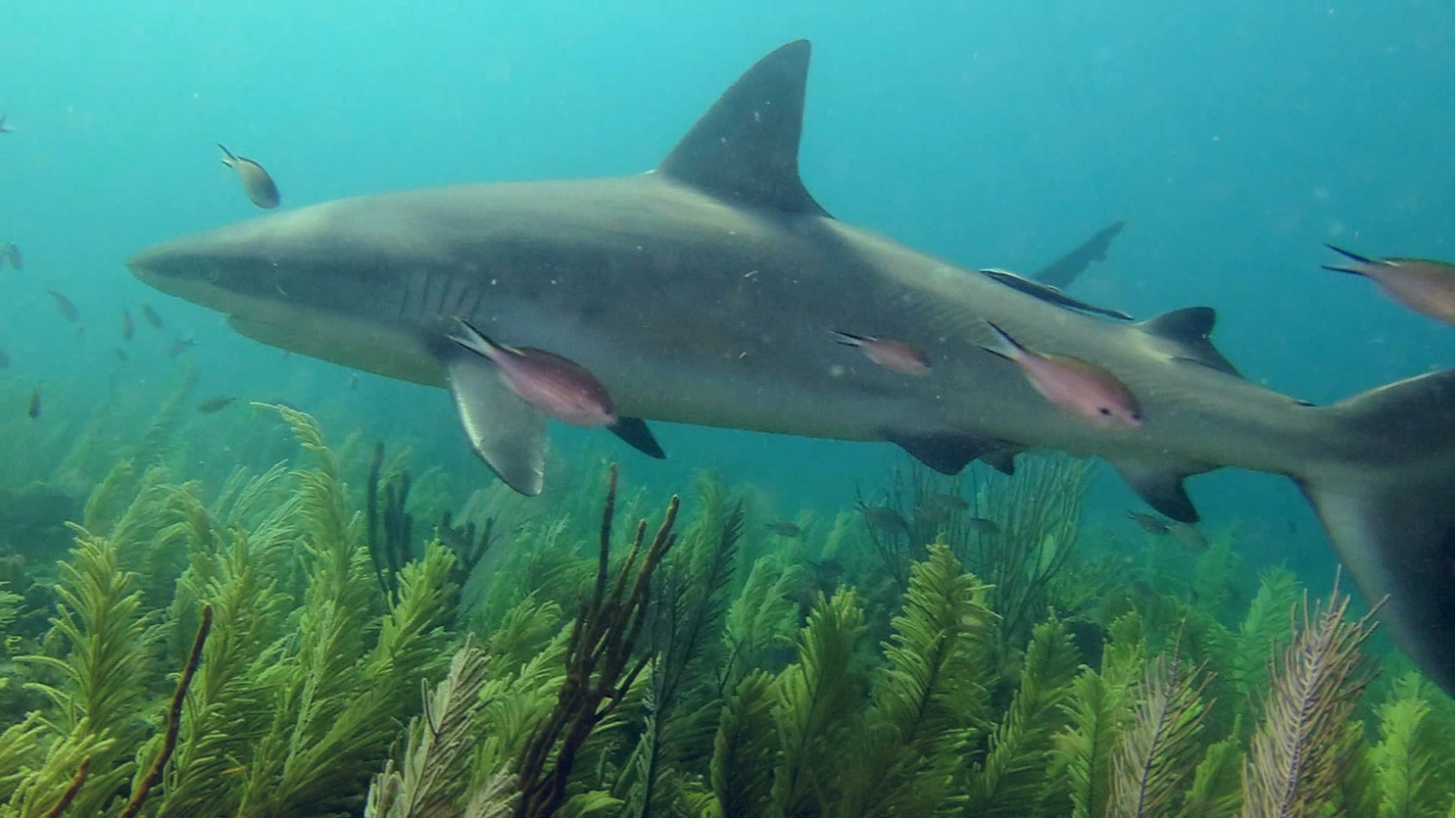
Exploring the Gardens of the Queen
Video Exploration

Slide 39
Archipelago- a chain or cluster of islands
The Gardens of the Queen is home to vast beds of seagrass and islands fringed with mangroves that are home to endemic plants and animals such as Cuban iguanas and hutias.
What it’s most famous for, however, are its exceptionally healthy coral reefs…perhaps the healthiest in the Caribbean. Here you can find, for example, large colonies of elkhorn coral. In South Florida, 95 percent of this species has been lost to disease and coral bleaching.

Slide 40
Sharks are also very common in The Gardens of the Queen. The presence of sharks is often an indication of a healthy coral reef. Large predators flourish when there is plenty of prey.
They also help to control prey populations. If sharks begin to disappear, for example, fish like parrotfish can take over.
Parrotfish are important because they graze on algae that can smother living coral and cover bare rock. If there are too many parrotfish on a reef, however, they will accidentally nip off too many living coral polyps which they are prone to do. Sharks keep those numbers in check.

Slide 41
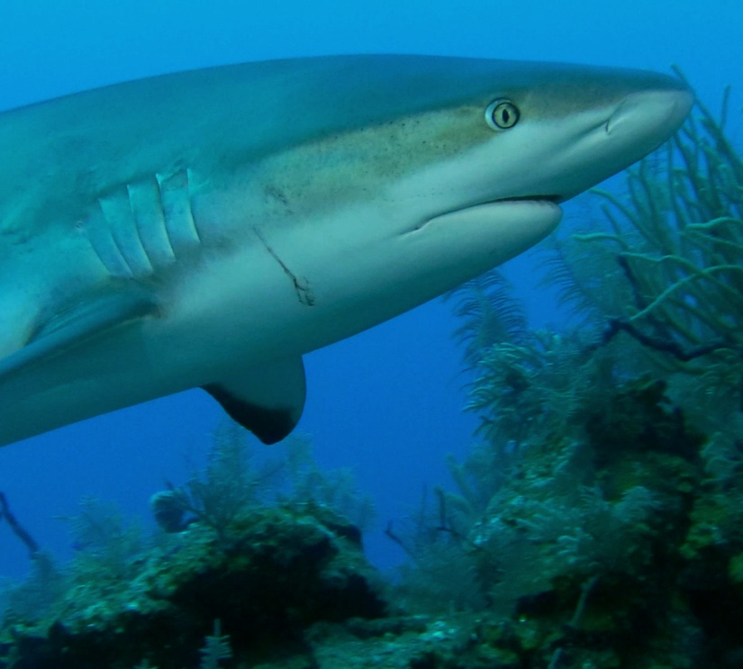
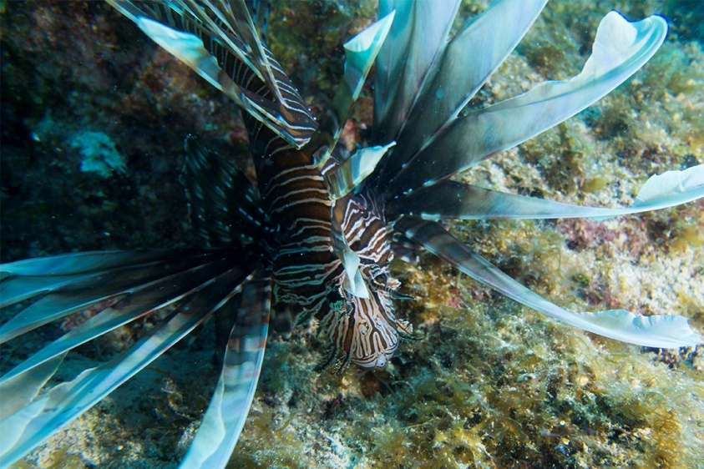
Sharks, such as Caribbean reef sharks, may also be an important line of defense against lionfish, an invasive fish from the Pacific Ocean that has taken over reefs throughout the Caribbean and the Gulf of Mexico.
Lionfish are frilled with venomous spines and eat about anything that will fit into their mouths.

Slide 42
Quiz #5
The “Gardens of the Queen” refers to:
A. An archipelago off the southern coast of Cuba
B. The first tobacco fields planted by Christopher Columbus
C. An area rich in orchid diversity in eastern Cuba
Which of the following statements is not true about sharks?
A. A Large population of sharks is an indicator of a healthy coral reef
B. Sharks control the populations of other reef fish
C. Sharks enjoy eating coral polyps
Lionfish are ________ to the Gardens of the Queen.
A. Endemic
B. Invasive
C. Beneficial
Return to menu

Slide 43
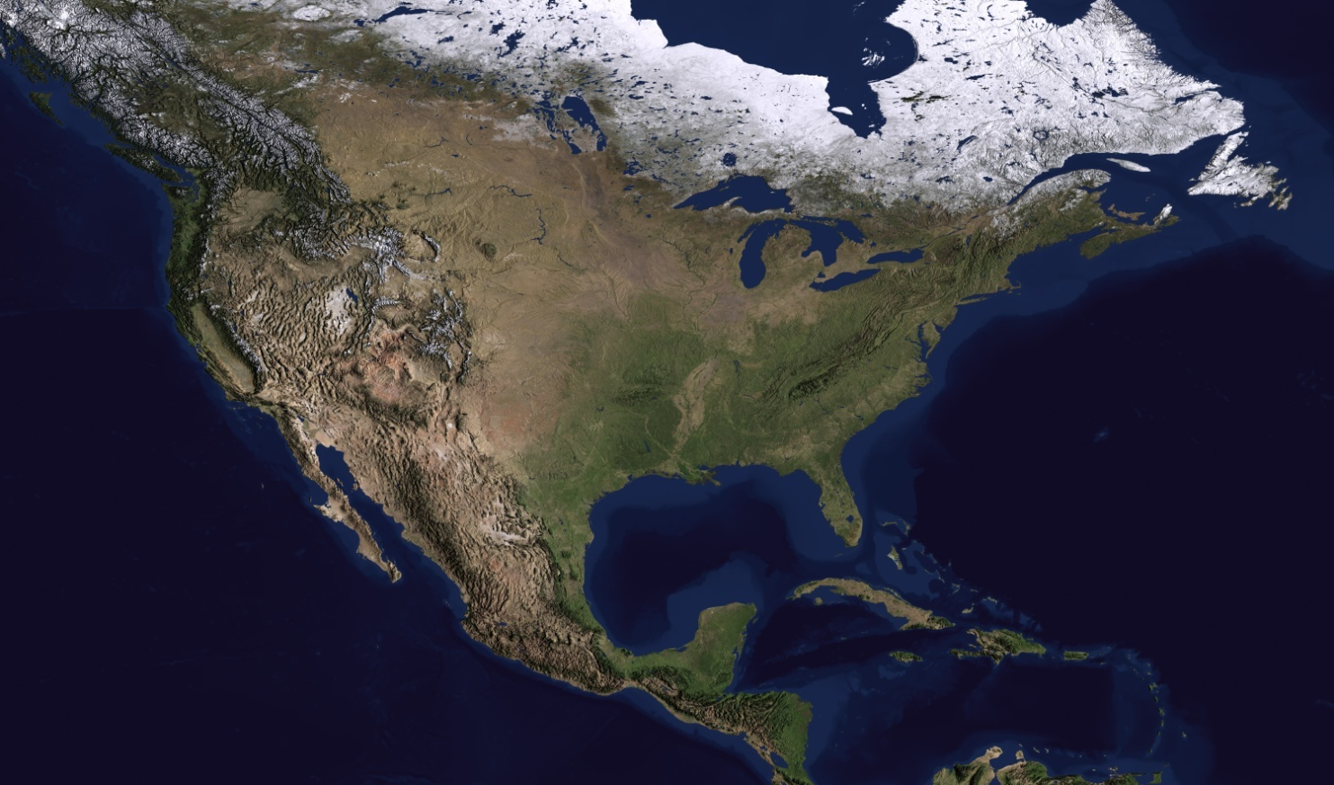
Currents and Connections
Most maps of the world show a planet that is divided up into countries, with lines that define the political boundaries of each country. When you look at a map of North America, for example, those lines are important and useful for us to understand where the United States is in relation to Canada or Mexico. In ecological terms, however, those boundaries don’t exist.

Slide 44
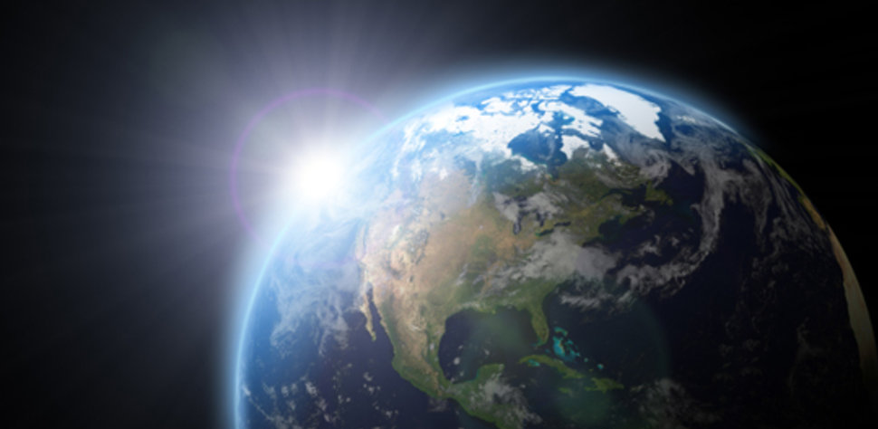
A Jaguar may roam from Sonora, Mexico to Arizona looking for a mate.
Every year, trade winds carry dust from the Sahara Desert to the Americas where it fertilizes the jungles of the Amazon.
The entire planet is connected. What happens in the Everglades affects Zapata Swamp and vice versa.

Slide 45
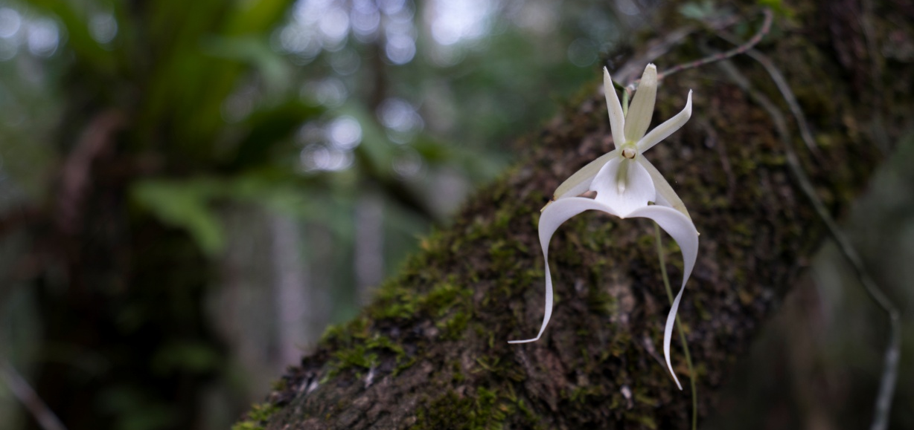
South Florida’s subtropical climate supports dozens of species of orchids that are found nowhere else in America. The ghost orchid is one of the most famous species in the world, inspiring enthusiasts to brave the cypress and pond apple swamps of the Everglades to see its delicate flower in person. This plant is both beautiful and rare.

Slide 46
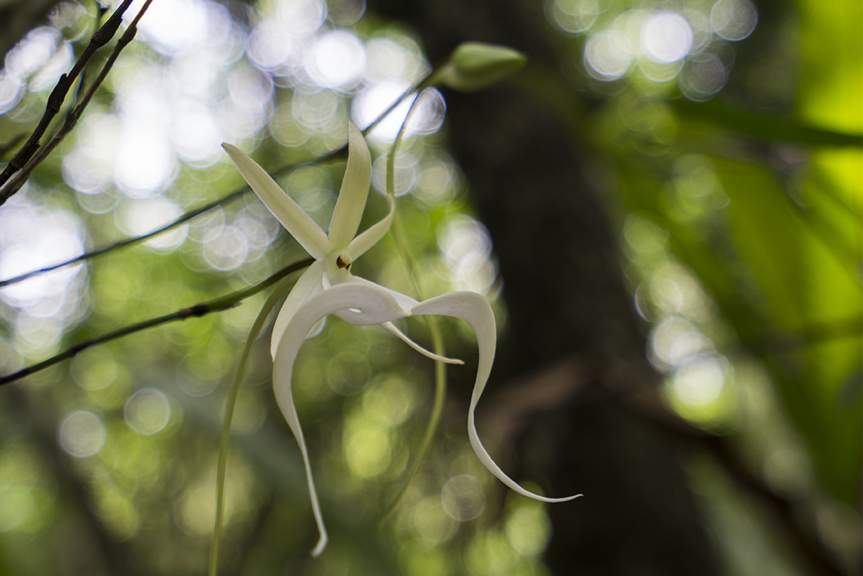
The ghost orchid’s seed pod is filled with millions of tiny, dust like seeds. When the pod eventually bursts open, those seeds drift with the wind where they will hopefully land on just the right kind of fungi growing on just the right kind of tree growing in just the right microclimate.

Slide 47
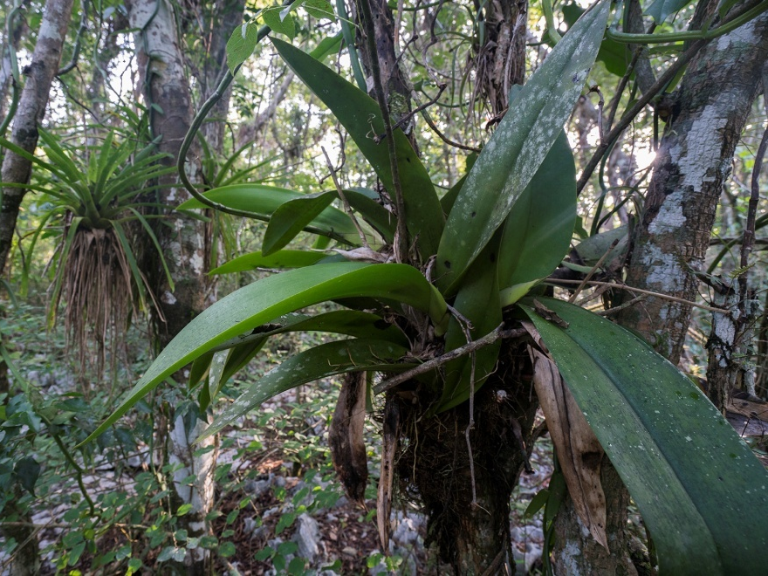
The ghost orchid is also found in the swamps of Cuba. In fact South Florida and Cuba share several species of orchids. Experts believe that many of Florida’s tropical orchids, including the ghost, originated from other parts of the Caribbean, Central and South America.
Because orchid seeds are as fine as dust, they can be transported huge distances on the winds of tropical storms and hurricanes.

Slide 48
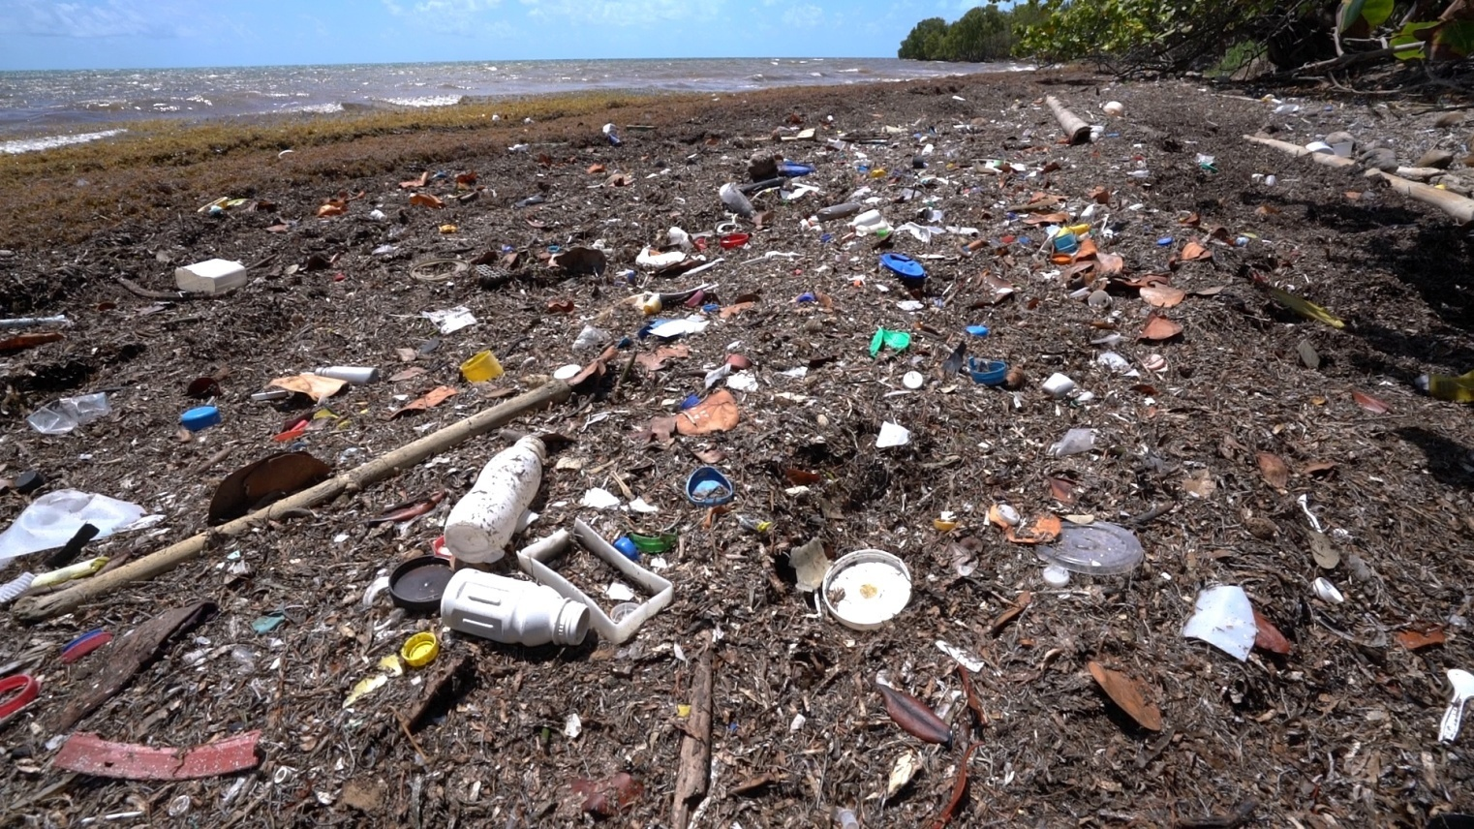
Carried by Currents
Video Exploration

Slide 49
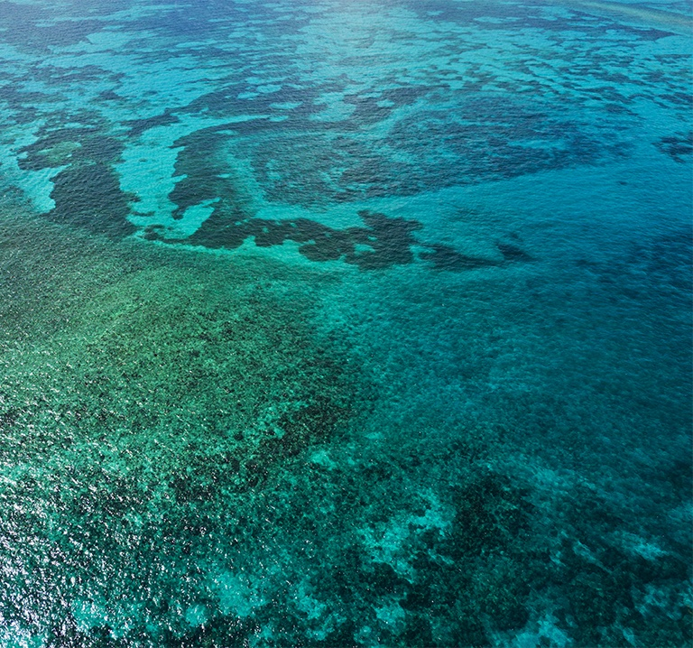
71% of the Earth’s surface is covered by ocean.
Ocean currents connect the world and are incredibly important for life as we know it. For one, oceans help to regulate the earth’s temperature. Oceans absorb heat, and that heat is often transported and distributed to deeper ocean layers through the mixing of waves and currents.
The oceans have been a great buffer for climate change, however, there are limits. Ocean surface temperatures are rising, and as we learned, that is having a negative impact on the world’s coral reefs.

Slide 50
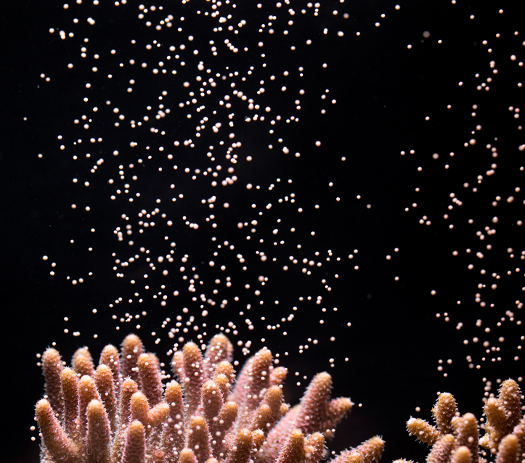
Currents like the Gulfstream are important “highways” of ecological transportation. Thousands of species of marine life employ those currents to distribute their larvae or to migrate from one area to another in search of food or spawning grounds.
Many species of corals and sponges, for example, employ the technique of “broadcast spawning,” releasing their eggs and sperm into the water at the same time. The fertilized eggs and later hatched larvae are transported by the currents. Where they eventually come to rest, a new reef may be born.

Slide 51
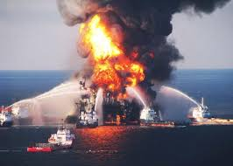
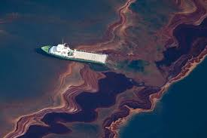
Unfortunately, the oceans currents also carry bad stuff, like oil. The catastrophic Deepwater Horizon spill in 2010 released an estimated 210 million gallons of oil into the Gulf of Mexico, affecting over 16,000 miles of coastline.
Oil is toxic to most marine life and the effects of this spill on seabirds, marine mammals, fish, etc. are still being studied.

Slide 52
An estimated 9 BILLION tons of plastic materials have been produced since the 1940’s and unfortunately, plastics do not biodegrade.
Much of the plastic waste that is discarded on land will eventually make it to the sea through interconnected rivers or storm drain systems
In the Pacific Ocean, there is now a gigantic patch of floating debris. This patch, larger than the state of Texas, can be seen from space.

Slide 53
Quiz #6
Ocean currents _________ the world.
A. Divide
B. Connect
C. Have no effect on
Which of the following statements is not true about ocean currents?
A. Many larval marine animals use them for transportation
B. They help to regulate the Earth’s temperatures
C. They accelerate global warming
Which of the following is true of plastic waste?
A. Plastic that is discarded on land rarely makes it to the sea
B. Plastics biodegrade in approximately 5o years
C. Humans have produced approximately 9 billion tons of plastic materials
Return to menu

Slide 54
Currents from Cuba Vocabulary Quiz
Endemic Species-
Biodiversity-
Exotic Species-
invasive Species-
Limestone-
a species that is non-native to the ecosystem and whose introduction causes or is likely to cause economic or environmental harm or harm to human health
plants and animals that exist only in one geographic region
species of plants or animals that are growing in a nonnative environment
a sedimentary rock composed of crystallized calcium carbonate (CaCO3)
refers to the variety and variability of life on Earth

Slide 55
6. Brackish-
7. Estuary-
8. Coral polyp-
9. Mutualism-
10. Archipelago-
F. a symbiotic relationship between two organisms of different species in which each individual benefits
G. a partially enclosed coastal body of brackish water with one or more rivers or streams flowing into it, and with a free connection to the open sea
H. a chain or cluster of islands
I. water that has more salinity (salt content) than fresh water, but not as much as seawater. It may result from mixing of seawater with fresh water, as in estuaries,
J. an individual coral animal

